Slide 1

Adventures in…
December
2023
Federal Funding Opportunities
Erin Reinders, AML’s Director of Infrastructure Development
AGFOA
Notes:
My name is Erin Reinders and I am the Director of Infrastructure Development with the Alaska Municipal League. After about 20 years in local government as a planning and city manager type, with 10 of those years out in Unalaska/Dutch Harbor, I have been with AML for about 1 year and a half…and I now get to help a whole bunch of communities throughout the state! I am super excited to be here today, thank you so much for including me.
I suspect many of you are already aware, so perhaps this can serve as a reminder…AML is a nonprofit member organization established in 1950, has a long history of directly supporting Alaska’s 165 cities and boroughs. This is accomplished through shared services, annual conferences and symposiums, ongoing communication with and advocacy for our members, and responsive technical assistance and training opportunities.

Slide 2
Opportunities
Resources
Successes
Lessons
Brainstorming
Notes:
Today we are going to talk about adventured in federal funding.
A bit about opportunities that now exist and how we might wrap our minds around it.
Available resources and support
Successful examples
Brainstorming about challenges and opportunities!
Title: Adventures in Federal Funding Opportunities
Summary: This session explores the twists and turns of federal funding, particularly in the context of BIL/IIJA and IRA. From navigating challenges to uncovering exciting opportunities, this discussion will highlight resources and strategies to successfully secure, leverage and implement federal funds for your projects. Please come with ideas and lessons learned to share with your friends and neighbors!
IN past
Hubs
Parthnerships grants
Direct – grant support
Parthnerships
Offic Hours
Capasity
Tipping point
Last year focu was on AML, this year, member focus
Fiffern for members p stories
reason to prosue grant fuing, fuing receive, which impact, feedback from partners, engate and part of , name them, draw in build up tippiong point

Slide 3

Infrastructure Investment
and Jobs Act (IIJA)/
Bipartisan Infrastructure Law (BIL)
Inflation Reduction Act (IRA)
Signed into law on November 15, 2021
Authorized $1.2 trillion for transportation and infrastructure spending
$550 billion of that figure going toward “new” investments and programs
Goal for Alaska is $3 billion/year for the next five years; including $1 billion in successful competitive grants
Signed into law on August 16, 2022
The IRA aims to reduce the federal deficit, cut greenhouse gas emissions and lower health insurance related costs while increasing health insurance coverage for vulnerable Americans
Invests $369 billion in climate and energy
Seeks to reduce greenhouse gas emissions by 40 percent below 2005 levels by 2030
OPPORTUNITIES
Notes:
The Infrastructure Investment and Jobs Act (IIJA), aka Bipartisan Infrastructure Law (BIL), was signed into law by President Biden on November 15, 2021. The law authorized $1.2 trillion for transportation and infrastructure spending with $550 billion of that figure going toward “new” investments and programs. Combination of formal funds and competitive grants.
IIJA is projected to bring about $18 billion to Alaska, or nearly $25,000 per Alaskan.
This is huge.
Additionally, on August 16, 2022 the Inflation Reduction Act (IRA) was signed into law. In terms of infrastructure, this focuses on climate and energy, investing $369 billion into related programs.
The scale and scope of federal funding for infrastructure opportunities is immense and overwhelming
This is truly a once in a generation sort of situation.
Many programs have >80% Federal Share, Rural set-asides
Emphasis on disadvantaged and rural - e
All good for Alaska in terms of competitive advantag

Slide 4
Transportation
Broadband
Energy
OPPORTUNITES
Resilience
Water & Sewer
Notes:
How can we think about this huge concept like infrastructure?
So last year I was into dividing things into buckets to make sense of all the programs being created and Notice of Funding Opportunities being released. I needed this for my own brain but also to help organize discussions and information with cities and boroughs.
Resilience, which includes wildfire management
Energy & Power - Upgrade Electricity and Transmission Infrastructure
Water & Sewer - Ensure Clean Drinking Water and Sanitation
Broadband (DE & Cyber) Provide High Speed Internet for All
Transportation - - Improve Transportation Systems ports, bridges, roads, transit and more
I think things that surround these buckets are concepts like workforce development, housing, even community facilities and equipment.

Slide 5
Grant Writing
and Project Management
Augment
Capacity
Increase Competitiveness
Bundle Projects and Data
OUR APPROACH
Improve Community Conditions
Deliver Funding and Projects
Strengthen Local Governments
Connect to Tools and Services
Notes:
But how can AML think about our approach as a member organization?
The scale and scope of federal funding for infrastructure opportunities is immense and overwhelming. But this is our approach to help!
Overarching Goal:
Maximize the benefit to Alaska and foster statewide collaboration, especially with all the opportunities coming from the Bipartisan Infrastructure Law.
Help position local governments for success by being a resource for partnerships, information, and guidance. We recognize that capacity is a hurdle for many, and want to augment that.

Slide 6
Cohort Support
OUR IMPACT
Notes:
Our outcomes…
Available resources and support
So, how does our approach impact each of you, what are the outcomes of those approaches?
Mixture of outreach and information sharing - emails, informational hubs, websites, weekly infrastructure office hours
Access to training, and Technical Assistance - connections to specialists, training opportunities (asset management sessions we are having this year as an example) s, governance assistance
Cohort support – I imagine we will be seeing more and more of these – some of you may have heard about Alaska Water Infrastructure Navigation Center and the associated Cohort Groups – we also have a Safe Streets for All working groups all focused on implementation of the same grant
Direct support - like grant writing
So this is a year in review, so I thought I would highlight some of these activities and successes from the past year.

Slide 7
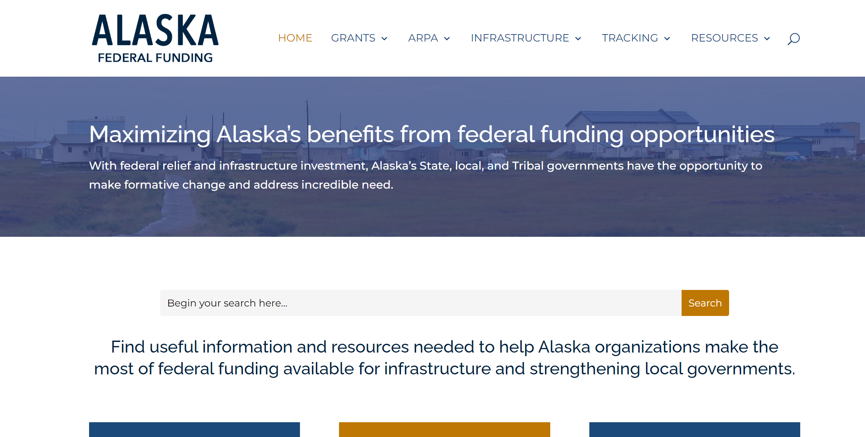
RESOURCES
Notes:
Available resources and support
AKFEDERAL FUNIDNG.org is thanks to the Alaska Infrastructure Coordinating Committee - AML, State of Alaska , University of Alaska, Denali Commission, AFN to name few
It includes…
News and grant information
Resource Links
Trainings/events
Match Requirement Form
Links to Transportation Hub & Energy Hub
Always looking to improve, so let us know your suggestions!

Slide 8
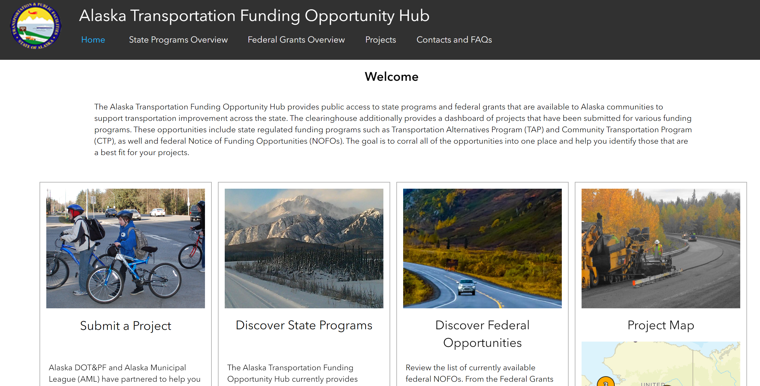
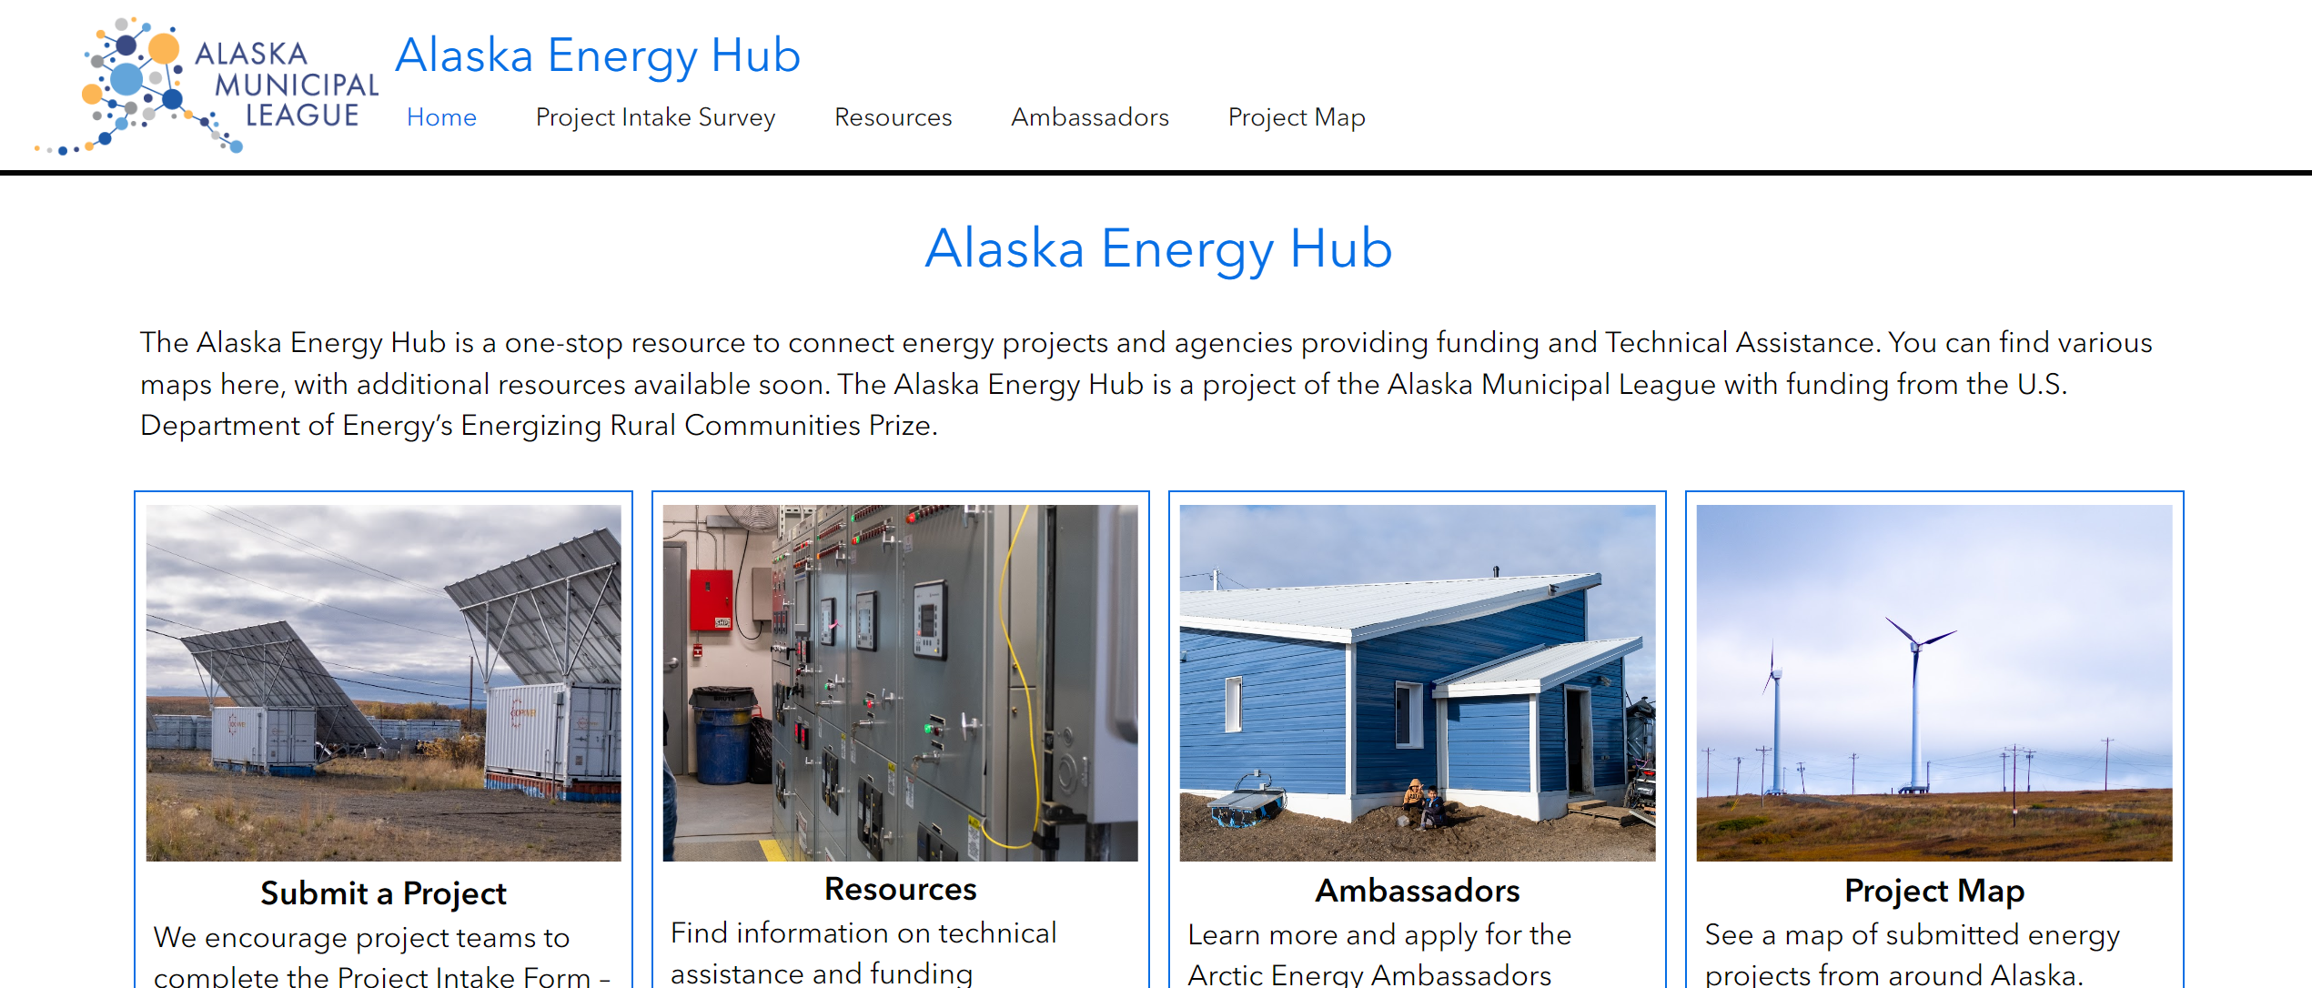
Get to these Hubs through:
https://akfederalfunding.org/
RESOURCES
Notes:
With Outreach and Information Sharing and Technical Assistance in mind…we can point to a couple of infrastructure hubs
Last year we were announcing the Transportation HUB, an outcome of AML’s partnership with Alaska DOT.
This Hub includes a project intake survey to express a transportation project concept and to be considered for assistance from DOT&PF and/or AML with project development and identifying funding opportunities.
There is the Project Map. The reason for this map is to give a visual representation of the need for transportation infrastructure across the state. It will also help group projects that may be more competitive as a bundled project and allow potential partners to seek each other out.
We are working to improve this now and welcome feedback. Britta or I will be happy to chat with you!
Today we announce the Energy Hub…
With funding from the U.S. Department of Energy Office of Clean Energy Demonstrations’ (OCED) Energizing Rural Communities Prize, we have launched the Alaska Energy Hub, a one-stop resource to facilitate the development of energy projects in the state.
The Energy Hub makes it easier for communities developing energy projects to connect with technical assistance providers and funding agencies, with the goal ensuring greater impact of federal funding to make Alaska’s energy infrastructure more affordable and sustainable.
AML is also helping Alaska’s DEC with EPA’s Carbon Pollution Reduction Program, including to develop statewide greenhouse gas emissions inventory. And in working with communities to identify potential projects as part of State plan, to become eligible for competitive funding to strengthen grids and lower costs.
Communities are encouraged to enter projects into this hub to be considered for including in this plan, or other technical assistance. Talk with Griffin to learn more!

Slide 9
Tuesdays at 9am, we are…
Over the past year, we have talked with…
Arctic Energy Office, FCC, FEMA, USDOT, Alaska DOT&PF, HDR, CISA, Structured, Katmai Solutions, State DEC, AML Team and each other!
Hearing from each other and guests
Sharing information on regarding infrastructure grants and implementation
Discovering opportunities for partnerships, collaboration or coordinated approaches
Learning about needs and how we can help each other!
Find out more on https://akfederalfunding.org/
Topics have included…
Energy Grants Programs, State and Federal Transportation Funding, NOFO Reviews and Updates, Mitigation Funding, Digital Equity, Cybersecurity, Lead Line Inventory, SRF Program, Climate Pollution Reduction Grant Program, Community Wildfire Protection Planning, Participant Updates
RESOURCES
Notes:
We also host Infrastructure Office Hours!
Think of this office hour as a time for coffee with friends. And is intended to be informal, adaptive and responsive. We have special guests on certain topics from time to time.
The hope is this can time a time to be with colleagues throughout the state and learn together.
This list on the side is not comprehensive!

Slide 10

Title
Here
RESOURCES
Grant Writing
Grant writing support for local governments, especially in disadvantaged communities.
Title
Description goes here.
Infrastructure Coordination
Community Benefits
Project manager for grants requiring capacity building, workforce development, and stakeholder engagement.
Title
Legislative support for AML coordination of information sharing, engagement, grant assistance and review. Hosting annual Infrastructure Symposium and akfederalfunding.org.
Description goes here.
Notes:
The scale and scope of federal funding for infrastructure opportunities is immense and overwhelming
Supporting local and Tribal governments with locating, applying, reporting, and compliance
Directly and indirectly facilitating grant writing support
Developing online resources to support grant process development

Slide 11
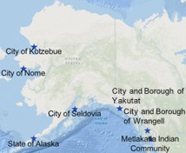
PIDP – Cold Bay Dock
  Awarded $43M for Cold Bay Replacement Dock.
  Owned by Borough, Managed by City, Applied for by State.
  This is the community’s only existing dock, which is nearing the end of its useful service life.
  As the town’s only marine connection, the new dock will be designed and built to accommodate commercial use, freight and fuel transportation, private vessel use, and public uses like emergency medical services and AMHS.
SUCCESSES
Notes:
Successes!
$43 million dollar has been awarded for the Cold Bay Replacement Dock.
Capacity and match can be a huge a challenge for communities (I am not even sure I need to say that, I suspect we can all just agree!). This grant was successful because of the close collaboration between Aleutians East Borough, City of Cold Bay and the State of Alaska – DOT. AML was very excited to assist and coordination! The State- recognizing this project’s importance supported the application not only by applying but by committing to the match.

Slide 12
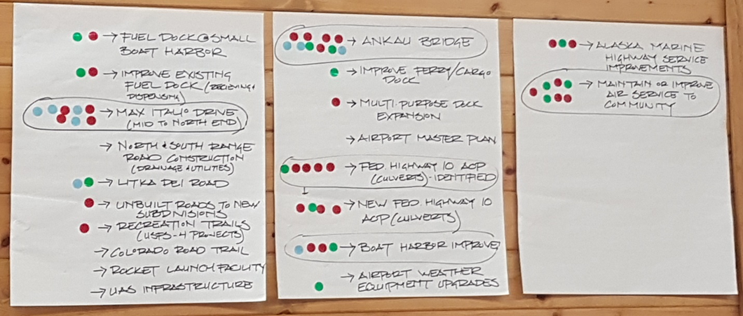
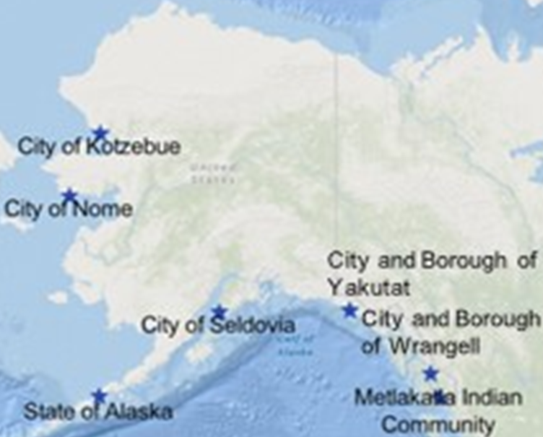
PIDP - Yakutat
Yakutat awarded $8.9M for construction of a New Small Boat Harbor. The project will replace the existing 60-year-old harbor. Work includes replacement of the floating dock, stringers, steel pipe mooring piles, and associated hardware. It also includes installation of a fire suppression system, covered gangway, and relocation of an existing seaplane float.
Yakutat Tlingit Tribe
Alaska DOT&PF
City & Borough of Yakutat
AML
SUCCESSES
Federal Highway Administration
Project identified as shared priority at Transportation Workshop last year!
US Forest Service
Notes:
AML was also happy to review the application for Yakutat. They were successful obtaining $8.9 M for Construction of a New Small Boat Harbor which is over 60-year-old.
Fun part is that around this time last year, AML was invited by Yakutat to help organize and coordinate a transportation workshop with the Tribe, City and State and Federal agencies. Together we identified shared transportation priorities and grant application strategies for funding them. This project was on that priority list! The application was able to point to this meaningful collaboration.

Slide 13
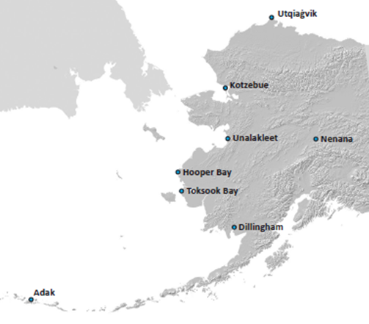
Energy Efficiency and Conservation Block Grant
  One of 12 other awardees in the nation totaling $8.8 million in awards to support the implementation of energy improvements.
  $900,000 going to Nenana as lead applicant.
  Will help 8 communities!
  AML will manage the project and facilitate technical expertise from additional partners.
  Energy Audits for public buildings and support improvements.
SUCCESSES
Notes:
This project will result in an energy assessments and efficiency & conservation plans for public facilities in 8 communities. The project will
increase energy efficiency
reduce diesel fuel consumption, and
lead to more economically delivered power to community facilities.
At the end of the project period, communities will have prioritized recommended energy efficiency and conservation actions and initiated progress toward at least one of those priorites in each community.
We thank Nenana for stepping up and taking on this lead applicant role.
The Alaska Municipal League will help to manage the project and facilitate technical expertise from additional partners.
This program was highly competitive, we learned that the group approach was very attractive to the funding agency. I encourage you to respond to these calls for interest! We are seeing meaningful results!

Slide 14

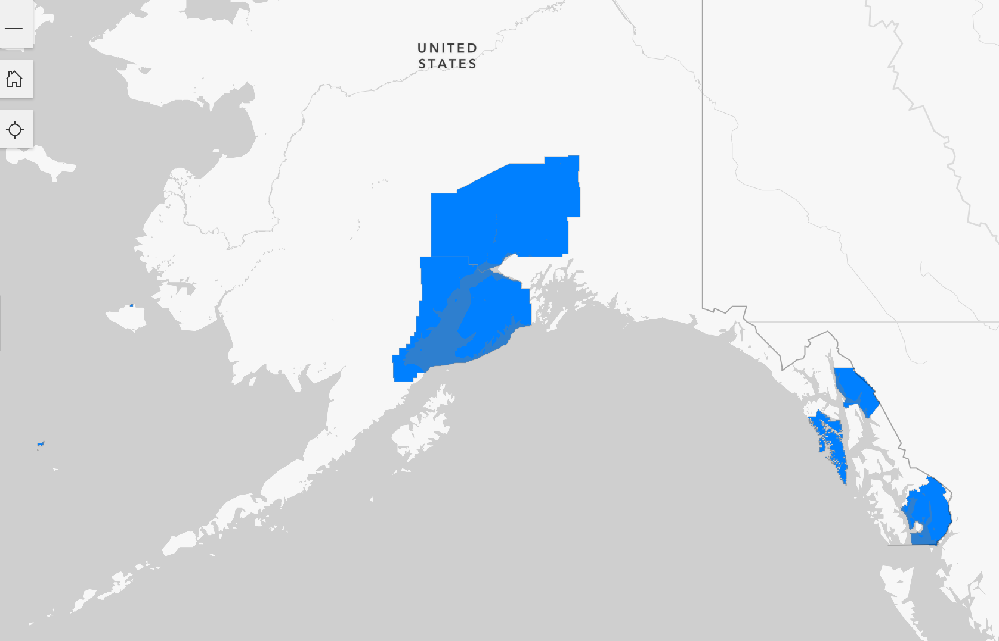
2022 SS4A Award Winners – Safety Action Plans - Totaling $2.7 Million
City and Borough of Juneau
City of Mekoryuk
City of Saint Paul (and Saint George)
Kenai Peninsula Borough
Ketchikan Gateway Borough
Matanuska-Susitna Borough
City and Borough of Sitka
SUCCESSES
Working group meets every month!
Notes:
7 communities were awarded funding to from the 2022 Safe Streets for All, each working on Safety Action Plans. Total for state was $2.7 million. These action plans will qualify these communities for implementation grants in the future.
AML hosts a monthly meeting open to all these communities so they may compare notes and learn from each other. So far that have shared what their experiences have been in the grant agreement process, and lessons learned. Saint Paul is kind of a rock star with this program and it really taking the lead within this group, they have been neighborly enough to share their RFP’s to help the others along in their processes.
Maybe we should repeat this concept with other grant programs!

Slide 15
Successful approaches…
Foster collaboration to maximizing the benefits for Alaska, including intergovernmental, local, and Tribal Governments.
Focused outreach directly to local and Tribal governments
Developing partnerships within and across regions to identify barriers, priorities, and solutions
Anticipate problem-solving needs and mechanisms to reduce costs, overcome challenges, and make the most of investment opportunity
Incorporate and reference your planning documents (or partner’s plans, State’s plans, Region’s CEDS…).
Are open and flexible with phasing. Some have planning grants first to qualify for consecution grants in the future. Find momentum!
Adapt and learn from the debriefs if a grant application is not awarded.
LESSONS

Slide 16
Takeaways include…
Application and distribution of BIL/IIJA funding will be spread across at least the next five years; implementation over the next ten
Many federal agencies are still developing NOFOs and programs
Identify new criteria for many programs, including equity, sustainability, new technologies, etc.
Federal agencies will continue to ramp up technical assistance
The State of Alaska will play a role in supporting communities
Many programs call for community benefits & public participation plans, and cost benefit analysis.
LESSONS

Slide 17
Needs, Assets, and Priorities: What are barriers you’re dealing with, and needs in the community? Who are you working with? What priorities have you identified?
Maintenance and Operations: What needs to be done to improve? On the other side of this investment, what does this look like? How can we prepare?
Procurement Planning: Are there statewide or regional approaches to procurement that could be considered? How to know and who could organize?
Intergovernmental Collaboration: How to encourage municipal and Tribal collaboration? How to work more closely with the State?
Match Requirements: What are match requirements that might keep you from applying for a grant? Where do you turn for help with match?
Tipping Point: What might cause you not to apply for grants? What are your experiences with implementation, and limits with that? What are some lessons learned?
BRAINSTORMING
Notes:
Lets brainstorm our challenges and opportunities!

Slide 18
Thank you!
Erin Reinders, Director of Infrastructure Development
Erin@akml.org
Notes:
Thank you all so much for a great year! Our plates are full and capacity may be limited. But I hope we can remember that we are all better off when we work together!
Friends, thank you all so much for all you do! Let’s have a great conference!

