Slide 1

Treasury 101
“All Things Treasury”

Slide 2
Government Finance Officers
Who’s here? What hats do you wear?

Slide 3

Why is it so hard to talk across disciplines?
Financial Professionals can focus on the same topic;
but use different lenses to analyze, adjust and report!

Slide 4



Classic 8-Slice
Party Slices
Zorro Style

Slide 5

Language Lesson
Easy Question → Tell me the fund balance of XYZ.
Fund Balance
means statement of net position or equity

Slide 6
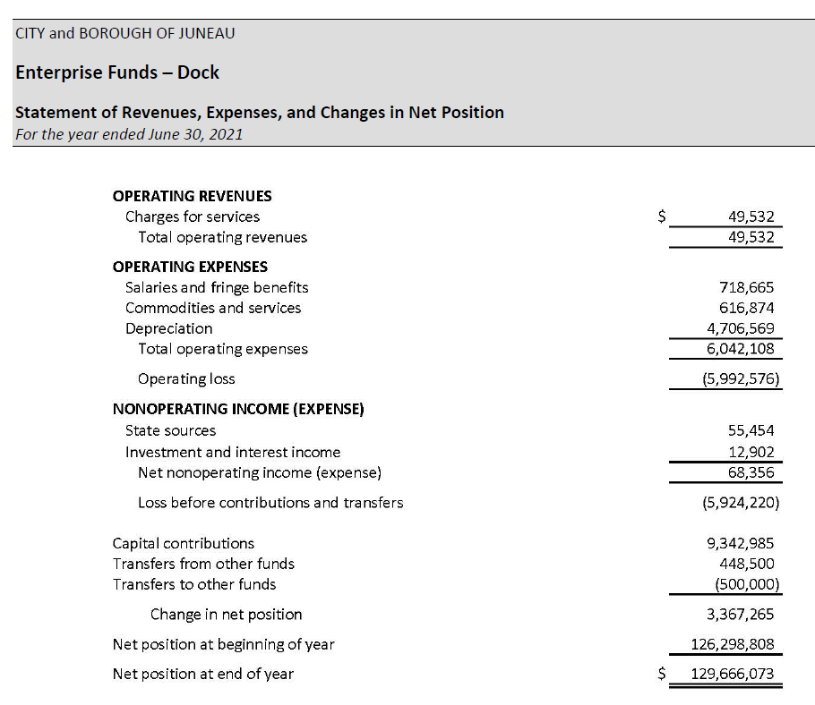
Fund Balance
means statement of net position or equity

Slide 7
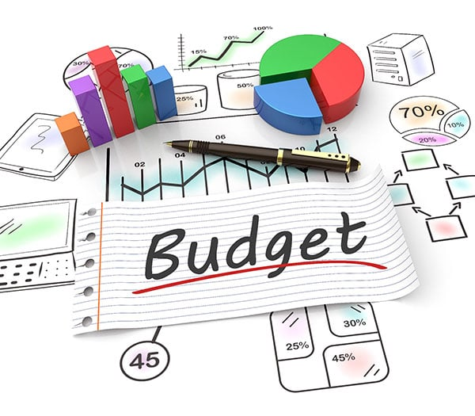
Language Lesson
Easy Question → Tell me the fund balance of XYZ.
Fund Balance
means how much can the department spend above their revenue?

Slide 8
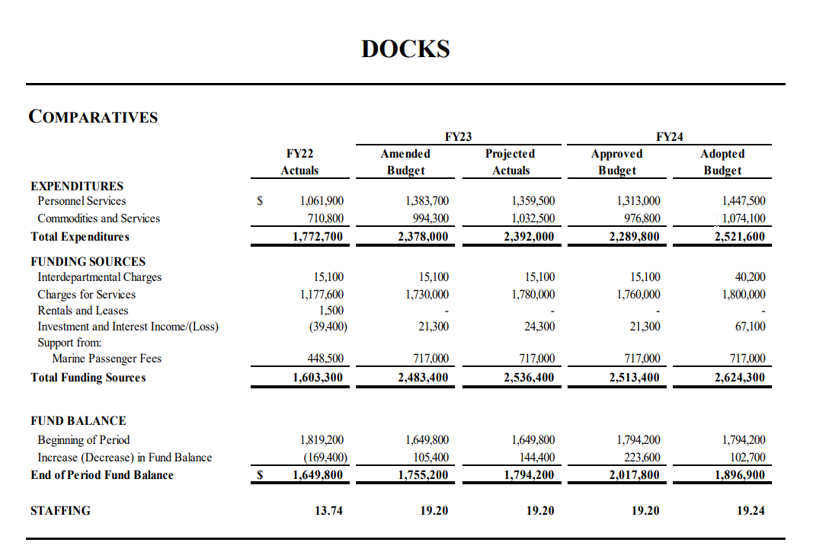
Fund Balance
means how much can the department spend above their revenue?

Slide 9


Language Lesson
Easy Question → Tell me the fund balance of XYZ.
Fund Balance
means a balance in an account at an institution

Slide 10
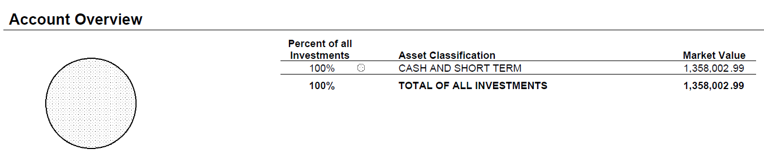
Fund Balance
means a balance in an account at an institution

Slide 11
Language Lesson
Easy Question → Tell me the fund balance of XYZ.
Clarify what’s really meant by the question or information request!

Slide 12
Treasury Operations
What makes up “Treasury”?
Cash Handling
Accounts Payable
Accounts Receivable
P-Cards
Property Taxes
Sales Tax
Utility Billing
Debt Management
Bond Management
Banking
Investments
Liquidity Forecasting and Management
Merchant Services (credit cards)

Slide 13
Treasury Operations - Juneau
What makes up “Treasury”?
Cash Handling
Accounts Payable
Accounts Receivable
P-Cards
Property Taxes
Sales Tax
Utility Billing
Debt Management
Bond Management
Banking
Investments
Liquidity Forecasting and Management
Merchant Services (credit cards)

Slide 14
Treasury Operations - Juneau
Treasurer
Revenue Officer
Banking Officer
Revenue Collector
Admin Assistant
Accounts Receivable Spvr
Accounting Tech III
Accounting Tech I
Sales Tax Supervisor
Sales Tax Comp Acct II
Accounting Tech I
Cash Office Supervisor
Accounting Tech III
Accounting Tech I
City Cashier
City Cashier
Accountant II
Accountant II
Sales Tax Comp Acct II
Accounting Tech I

Slide 15
Treasury Operations – Revenue
Accounts Receivable
Generate Property Tax Bills
Billing for:
  Land Purchases
  Housing Loans
  Airport Leases
  Gravel
  Property Taxes
  Parking Tickets
Sales Tax
Sales Tax reporting and remittance
Compliance Audits
Estimations
Resale Exemption Cards
Senior Exemptions
Hardship Rebate
Short-Term Rental Registration

Slide 16
Treasury Operations – Revenue
Collections
Delinquencies:
  Sales Tax
  Property Taxes
  Utilities
  Others as requested

Slide 17
Treasury Operations – Banking
Cash and Banking
Cash Office
  Receives payments in person, mail and drop boxes
  Sells bus passes
  Petty Cash
  Bank Deposits
Departmental Deposits
Electronic Payments
Paymentus (Sales Tax)
Invoice Cloud
Credit Card (World Pay)
ACHs & Wire Transfers
Cash Accounting
Reconciliation to Bank
  School District, Hospital
  CBJ activity and payroll

Slide 18
Treasury Operations – Treasurer
Debt
Bond Servicing
  Payments
  Arbitrage
DEC Loans
Investments
Short-term
Mid-term
Long-range
Systems
Govern
Lawson

Slide 19

Treasury Operations – Connecting Across Finance
Every transaction that occurs in Treasury has an impact on the general ledger, financial statements and budget.

Slide 20
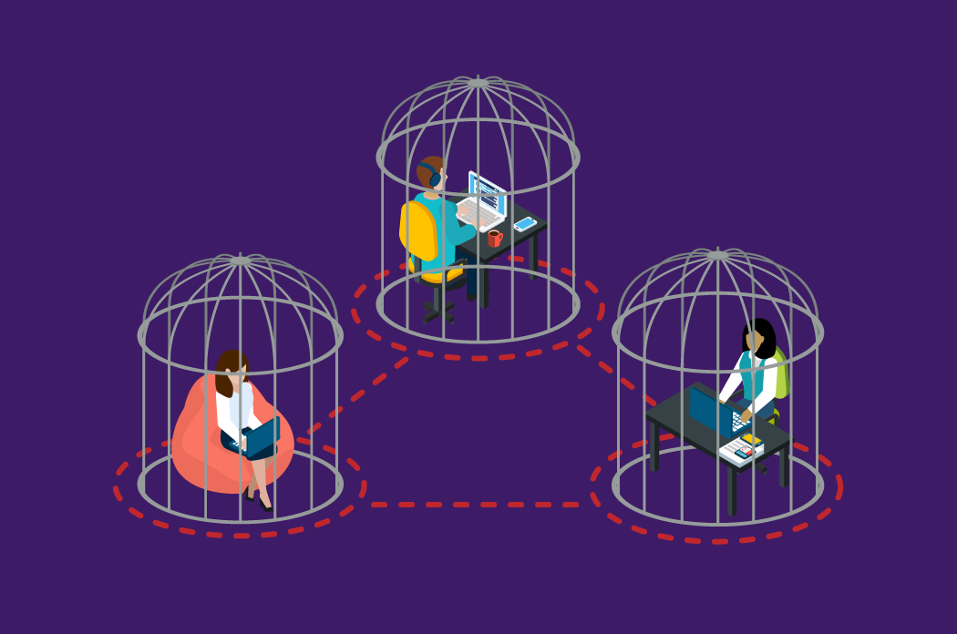
Treasury Operations – Connecting Across Finance

Slide 21
Treasury Operations – Connecting Across Finance
Weekly Discussion
Accounting
Budget
Treasury

Slide 22
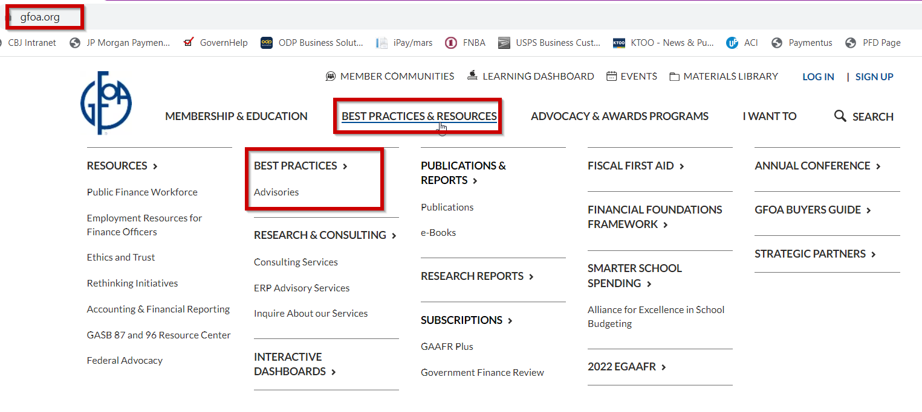
So much to learn!!!

Slide 23
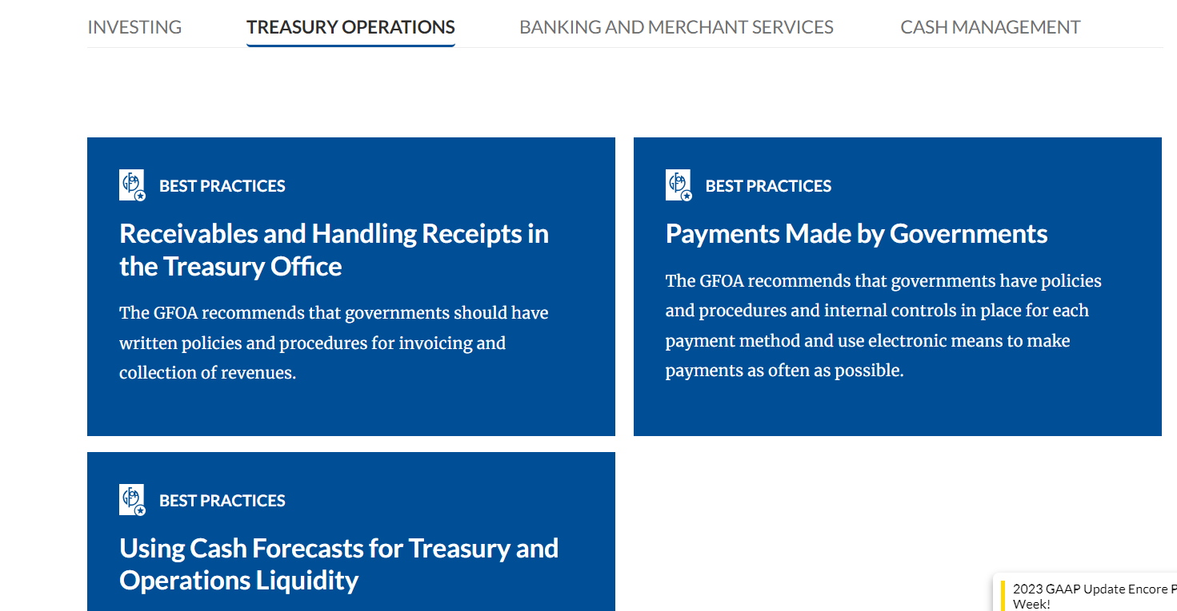
So much to learn!!!

Slide 24
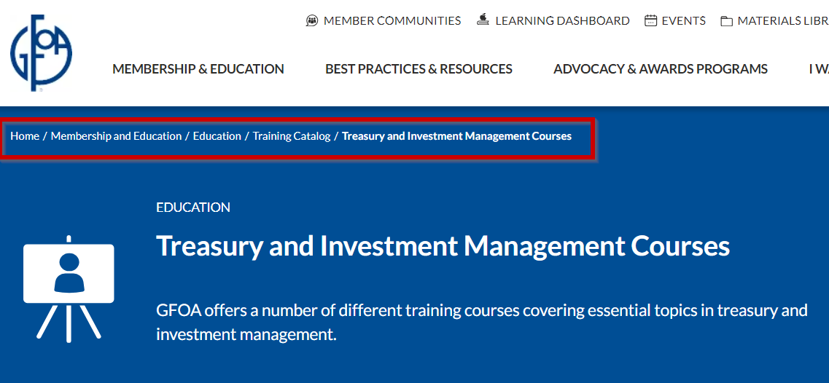
So much to learn!!!

Slide 25
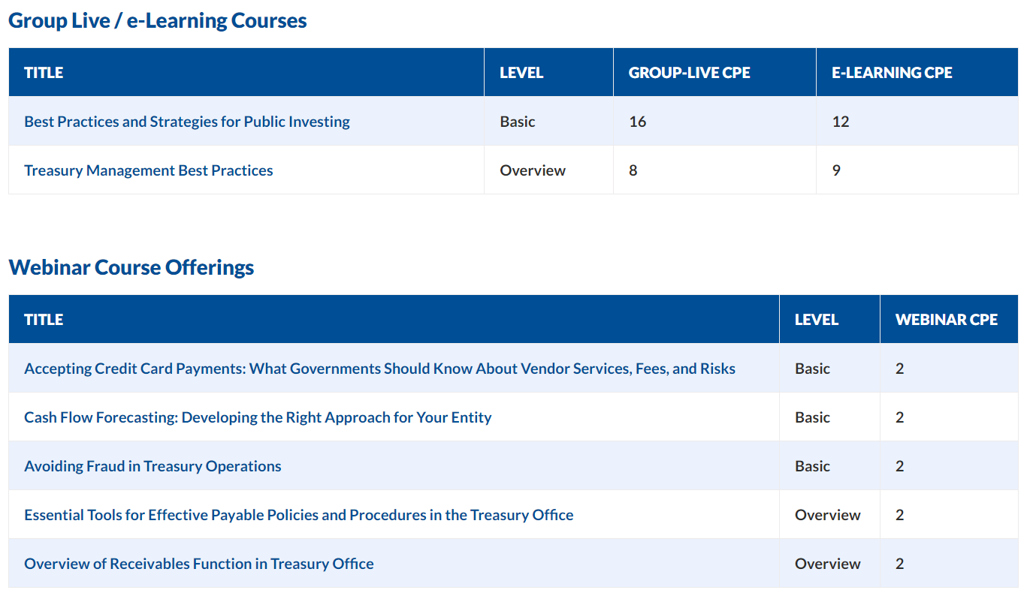
So much to learn!!!

Slide 26

Questions?
Angie Flick, PhD
Finance Director
Angie.Flick@juneau.gov
907-586-5215 ext 4057

