Slide 1
Alaska GFOA GASB Update
Alan Skelton, Director RTA

Slide 2
June 30 Effective Dates— As of July 2020
June 30: Fiscal Year 2021
Statement 84—Fiduciary Activities
Statement 90—Majority Equity Interests
June 30: Fiscal Year 2022
Implementation Guide 2019-1—Update
Implementation Guide 2019-2—Fiduciary Activities
Statement 93—Replacement of Interbank Offered Rate
Statement 87—Leases
Statement 89—Interest Cost Incurred before the End of a Construction Period
Statement 92—Omnibus 2020 (multiple effective dates)
Implementation Guide 2019-3—Leases
Implementation Guide 2020-1—Update
Statement 97—CCUC and Section 457 Plans
June 30: Fiscal Year 2023
Statement 94—Public Private Partnerships
Statement 96—Subscription-Based IT Arrangements
Statement 91—Conduit Debt

Slide 3
June 30 Effective Dates – As of September 2023
Statement 91 – conduit debt
June 30: Fiscal Year 2023
Statement 94 – public-private partnerships
Statement 96 – SBITAs
IG 2020-1 – update (4.6–4.17 and 4.19–4.21)
IG 2021-1 – update (4.1–4.21, 4.23, 5.2, and 5.4)
June 30: Fiscal Year 2024
IG 2021-1 – update (5.1)
Statement 99 – omnibus 2022 (leases, PPPs, and SBITAs)
Statement 99 – omnibus 2022 (financial guarantees and classification of derivatives)
Statement 100 – accounting changes and error corrections
June 30: Fiscal Year 2025
Statement 101 – compensated absences

Slide 4
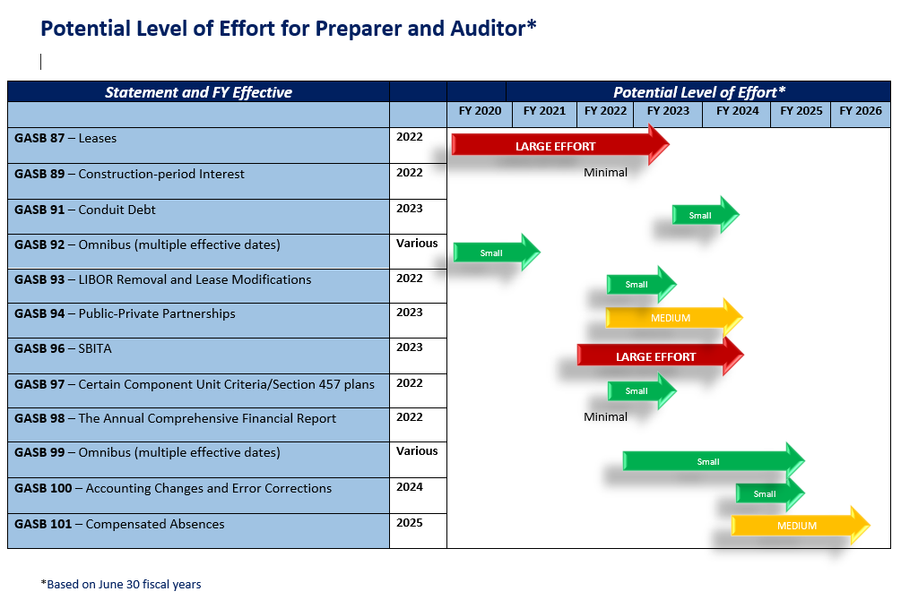
New GASB Statement Impact

Slide 5
Current Technical Agenda Projects

Slide 6
Technical Plan Overview – As of April 2022
Practice Issues:
  Accounting Changes and Error Corrections
  Compensated Absences
  Implementation Guide—Update
  Nonfinancial Assets
  Omnibus
  Certain Risks Disclosures
Pre-Agenda Research Activities:
  Capital Assets
  Subsequent Events
Conceptual Framework:
  Disclosure Framework
  Recognition
Comprehensive Projects:
  Financial Reporting Model Re-examination
  Revenue and Expense Recognition
Major Projects:
  Going Concern and Severe Financial Stress

Slide 7
Technical Plan Overview – As of August 2023
Practice Issues:
  Accounting Changes and Error Corrections (100)
  Compensated Absences (101)
  Implementation Guide—Update
  Nonfinancial Assets
  Omnibus (99)
  Certain Risks Disclosures
  Subsequent Events
Pre-Agenda Research Activities:
  GAAP Structure
  Capital Assets
  Subsequent Events
Conceptual Framework:
  Disclosure Framework
  Recognition
Comprehensive Projects:
  Financial Reporting Model Re-examination*
  Revenue and Expense Recognition
Major Projects:
  Going Concern / Severe Financial Stress
  Infrastructure Assets
  * - Governmental Funds removed 06/2023

Slide 8
Pre-Agenda Research / Monitoring
Post-Implementation Reviews (PIR)

Slide 9
Monitoring
Digital Assets
Electronic Financial Reporting
Environmental Credits
Other
SBITA Implementation

Slide 10
New GARS Platform…
Launched earlier in 2023
Free access (professional view is no longer needed for elevated access)
Improved user interface, search functionality, additional tools

Slide 11
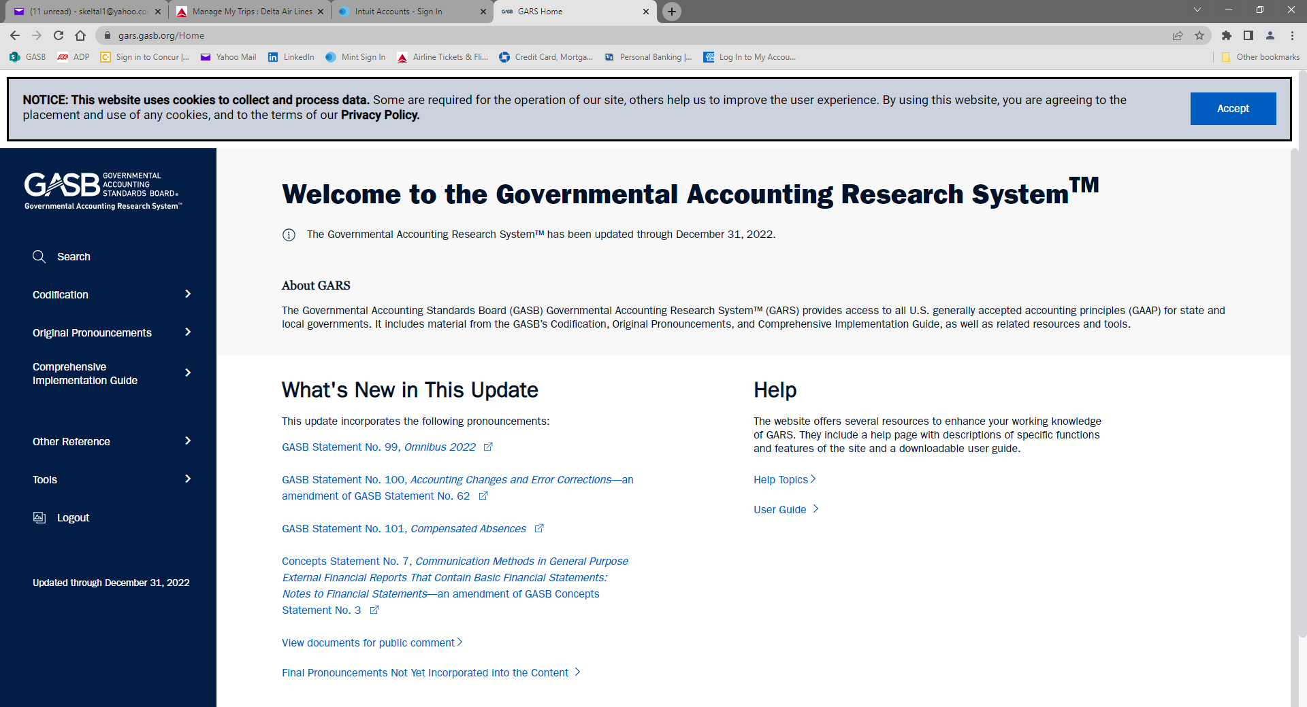
New GARS platform…

Slide 12
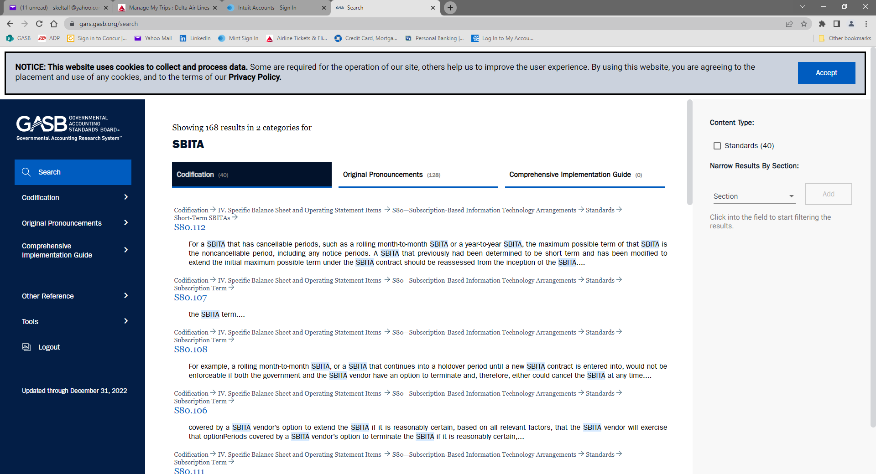
New GARS platform…

Slide 13
Statements being Implemented

Slide 14


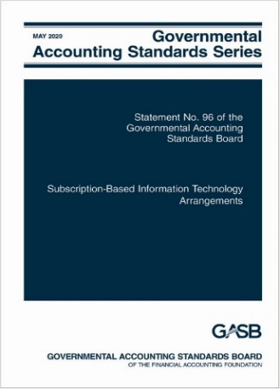
Right-to-Use Statements
Statement 87
Leases
Statement 94
Public-Private and Public-Public Partnerships and Availability Payment Arrangements
Statement 96
Subscription-Based Information Technology Arrangements

Slide 15
Definitions – Leases, PPP, and SBITA
Lease - a contract that conveys control of the right to use another entity’s nonfinancial asset (the underlying asset) as specified in the contract for a period of time in an exchange or exchange-like transaction.
P3 - arrangement in which a government (the transferor) contracts with an operator [governmental or nongovernmental] to provide public services by conveying control of the right to operate a nonfinancial asset, such as infrastructure or other capital asset (the underlying PPP asset), for a period of time in an exchange or exchange-like transaction.
SBITA - a contract that conveys control of the right to use another party’s (a SBITA vendor’s) IT software, alone or in combination with tangible capital assets (the underlying IT assets) as specified in the contract for a period of time in an exchange or exchange-like transaction.

Slide 16
Relationship between Leases and P3
Meets both lease and P3 definitions
Meets SCA
Statement 94 SCA guidance
Does not meet SCA
Underlying PPP assets not existing assets of transferor
Underlying PPP assets existing assets of transferor
Statement 94 P3 guidance
Improvements required to be made by operator
Improvements not required to be made by operator
Statement 94 P3 guidance
Statement 87

Slide 17
Relationship between Leases and SBITAs
All SBITAs meet definition of lease
Depends on what the underlying asset is:
  Tangible capital assets alone – Statement 87
  IT software alone – Statement 96
  IT software in combination with tangible capital assets:
    Software component is insignificant compared to cost of tangible capital asset – Statement 87
    Otherwise – Statement 96
Also excluded from Statement 96:
  Governments acting as SBITA vendors
  Contracts that meet the definition of a P3 in Statement 94
  Perpetual software licenses

Slide 18
Topics That Are The Same
Lease/PPP/Subscription Term
  Noncancellable period plus certain optional periods
    One party has option - reasonably certain will extend or not cancel
  Excludes cancellable periods – both parties can cancel
Short-Term Lease/SBITA
  Maximum possible term of 12 months or less
    Includes all one-party options to extend
    Excludes cancellable periods
  Recognize expense/expenditure or revenue (applies to lessors too) based on contract

Slide 19
Topics That Are The Same
General recognition and measurement
  Intangible right-to-use asset and liability (lessee/operator/SBITA)
  Receivable and deferred inflow of resources (lessor/transferor)
Contracts with multiple components
  Generally, account for lease and non-lease components as separate contracts and multiple underlying assets as separate lease components
  Allocate contract price to different components
Modifications and terminations

Slide 20
Key Implementation Issues – GASB 87
Much of GASB 87 is driven by the legal form of the contract
If contract gives either party the option to cancel, even if it is highly unlikely that they wont, it is a cancellable period (Q4.15 in IG 2019-3)
If renewal is an option within the contract versus there being a new contract:
Need to exercise professional judgment
Is it an exchange or an exchange-like transaction—definition of a lease
Whether payments are fixed in substance
It determines whether renewal history matters—it matters if there is a renewal option and it does not matter if it is a new contract (Q4.11 in IG 2020-1)
Could change the short-term lease evaluation (Q4.10 in IG 2020-1)
Estimating the incremental borrowing rate (discount rate) if no similar debt has been issued

Slide 21
Key Implementation Issues – GASB 87
Transition provisions
Statement 87 requires that leases be recognized and measured using the facts and circumstances as of the beginning of the period of implementation
For example:
As of January 1, 2022 for FYE December 31, 2022
As of July 1, 2021 for FYE June 30, 2022
Not allowed to go back to the actual beginning of the lease
Materiality
Materiality is always a consideration

Slide 22
Lease and SBITA Topics
While GASB does not enforce compliance, we can infer the following leases issues based on conversations with stakeholders.
  What is the lease population?
  Do I have access to all the contracts?
  Does the government have all the amendments to the lease?
  What is the right level of materiality for leases/SBITA? $5,000?
  How do I know if my subscription contract grants control of the right to use the vendor's software?
  What do I do if the government is acting as the SBITA vendor?

Slide 23
Lease and SBITA Topics
Questions most often fielded by the team
  Definition/scope
    Does this contract convey control of the underlying asset?
    Is it an exchange or exchange-like transaction?
  Transfer of ownership
    Does a bargain purchase option count?
  Evaluating options
    One-sided (lessee only or lessor only) vs two-sided (both lessee and lessor) – treated differently for short-term and lease term evaluations
  Liability/receivable calculation
    How to measure when payments based on CPI
    How to estimate incremental borrowing rate
  Transition
    Measuring as of implementation date vs beginning of lease
    Whether to recognize expenditure and OFS in governmental funds for in-process leases

Slide 24
Topics Unique to Statement 94
Service Concession Arrangements
  Retained definition from Statement 60
    Except for public services do not have to relate to primary function of underlying asset
  Retained general approach from Statement 60
New or Improved Underlying PPP Assets
  Transferor:
    SCA – recognize at acquisition value when placed in service
    Not SCA – recognize receivable at operator’s estimated carrying value at date of future transfer and additional deferred inflow
  Operator:
    SCA – recognize intangible right-to-use asset
    Not SCA – recognize deferred outflow and liability for future transfer

Slide 25
Topics Unique to Statement 94
Availability Payment Arrangements
  Government contracts with another entity to operate or maintain the government’s nonfinancial asset
  Entity receives payments from the government based on the asset’s availability for use
  Asset’s availability may be based on the physical condition of the asset or the achievement of certain performance measures
  May include design, finance, construction, or service components
    Design, construction, financing components and ownership transfers – financed purchase
    Service components – outflows of the period
What is the difference between a P3 and APA…it is really about who maintains the right to determine rates? Did it remain with the government (transferor) or was it provide to the other entity?

Slide 26
Topics Unique to Statement 96
Implementation Costs
  Preliminary project stage
    Expense
  Initial implementation stage
    Generally capitalize
    Expense if short-term SBITA
  Operation and additional implementation stage
    Generally expense
    Capitalize if specific criteria met
  Training costs always expensed

Slide 27
Topics Unique to Statement 96
Subscription Term
  Commences when initial implementation stage is completed
  No subscription liability or subscription asset until then
  Payments made before are prepayment until commencement
Multiple Modules
  Subscription term begins when first module (or set of interdependent modules) is implemented

Slide 28
Proposed SBITA Questions and Answers
Q—Is a licensing agreement for a vendor’s computer software that automatically renews until cancelled a licensing agreement that provides a perpetual license?
    A—No. A provision under which a licensing agreement automatically renews until cancelled is an option to terminate the agreement at each renewal date. An agreement that includes an option to terminate is not a purchase, whereas a perpetual license is a purchase in which a government is granted a permanent right to use the vendor’s computer software. Therefore, a licensing agreement for a vendor’s computer software that automatically renews until cancelled does not provide a perpetual license.

Slide 29
Proposed SBITA Questions and Answers
Q—A government enters into a six-year subscription-based information technology arrangement (SBITA) contract with no options to extend or terminate the contract and begins making semi-annual subscription payments to the SBITA vendor immediately after the contract takes effect. The initial implementation stage is not completed until the end of the second year after the contract takes effect. What is the subscription term?
  A—The subscription term is four years. The initial implementation stage is completed at the end of the second year of the contract. Therefore, in accordance with paragraphs 9 and 15 of Statement 96, the subscription term commences at the beginning of the third year and ends at the conclusion of the sixth year when the SBITA contract ends.

Slide 30
Edited (from Proposed) SBITA Question and Answers
Q—For purposes of determining the applicability of Statement 96, do Software as a Service, Platform as a Service, and Infrastructure as a Service contain a combination of IT software and tangible capital assets)?
  A—Yes. Software as a Service, Platform as a Service, and Infrastructure as a Service are three common deployment models of cloud computing arrangements. Notwithstanding the labels of those arrangements, each deployment model contains IT software used in combination with tangible capital assets. To further assess the applicability of Statement 96, the substance of the arrangement should be evaluated in accordance with all aspects of paragraph 6 of that Statement to determine whether the arrangement meets the definition of a subscription-based information technology arrangement (SBITA).

Slide 31
Implementation Guidance
Implementation Guide No. 2019-3, Leases
  77 questions and answers (authoritative)
  3 illustrations (nonauthoritative)
Implementation Guide No. 2020-1, Implementation Guidance Update—2020
  12 questions and answers about Statement 87 (authoritative)
Implementation Guide No. 2021-1, Implementation Guidance Update—2021
  19 questions and answers about Statement 87 (authoritative)
Implementation Guide No. 2023-1, Implementation Guidance Update—2021
  6 questions and answers about Statement 87 (authoritative)
  3 questions and answers about Statement 96 (authoritative)

Slide 32
Effective Dates
Pronouncement | Beginning After
Statement 87 | June 15, 2021*
Statement 94 | June 15, 2022**
Statement 96 | June 15, 2022*
Implementation Guide 2019-3 | June 15, 2021*
Implementation Guide 2020-1 (Statement 87 questions) | December 15, 2021*
* Fiscal years beginning after this date, and all reporting periods thereafter
** Reporting periods beginning after this date

Slide 33

Conduit Debt Obligations
Statement No. 91

Slide 34
Conduit Debt
What?
Why?
When?
The Board improved the standards related to conduit debt obligations by providing a single reporting method for government issuers
Interpretation 2 had been in effect for 20 years before its effectiveness was evaluated; based on GASB research, improvements were needed to eliminate diversity in practice
Effective for periods beginning after December 15, 2021
Earlier application is encouraged

Slide 35
Definition of Conduit Debt
There are at least three parties involved: the government-issuer, the third-party obligor (borrower), and the debt holder or trustee.
The issuer and the third-party obligor are not within the same financial reporting entity.
The debt obligation is not a parity bond of the issuer, nor is it cross-collateralized with other debt of the issuer.
The third-party obligor or its agent, not the issuer, ultimately receives the proceeds from the debt issuance.
The third-party obligor, not the issuer, is primarily obligated for the payment of all amounts associated with the debt obligation.

Slide 36
Limited, Additional & Voluntary Commitments Extended by Issuers
Generally, issuers’ commitments are limited to the resources provided by the third-party obligor.
Occasionally, an issuer may extend an
additional commitment
to support debt service in the event of the third-party obligor’s default.
For example:
Extending an appropriation pledge
Extending a financial guarantee
Pledging its own property, revenue, or other assets as security
Extending a moral obligation pledge
Under a voluntary commitment, issuer voluntarily decides to make a debt service payment or request an appropriation for a payment in the event that the third-party is, or will be, unable to pay.

Slide 37
Recognition by the Issuer
Do not recognize a conduit debt obligation as a liability
May have a related liability arising out of an additional or voluntary commitment
Additional commitment: report a liability when qualitative factors indicate it is more likely than not that the issuer will support debt service payments for a conduit debt obligation
Voluntary commitment: if a certain event or circumstance has occurred, evaluate likelihood, then report a liability if it is more likely than not that the issuer will support debt service payments
Voluntary commitments for which a liability is recognized and all additional commitments: At least annually reevaluate whether recognition criteria are met while conduit debt is outstanding
Notes:
Box 3: The list of qualitative factors in paragraph 13 should be used to assess whether it is more likely than not an issuer will support debt service payments.

Slide 38
Arrangements and Capital Assets
Some conduit debt obligations include
arrangements* that involve capital assets to be used by the third-party obligor but owned by the issuer.
Payment schedule of the arrangement coincides with the debt service repayment schedule.
Capital asset is built or acquired with proceeds of the conduit debt obligation.
Payments from the third-party obligor are to cover debt service payments.
Issuer retains title to the capital asset from the beginning of the arrangement.
*Often characterized as “leases”

Slide 39
Arrangements and Capital Assets (continued)
Accounting by the issuer:
Do not report those arrangements as leases
Do not recognize a liability for the related conduit debt obligations
Do not recognize a receivable for the payments related to those arrangements
If the arrangement meets the definition of a service concession arrangement, follow Statement 60

Slide 40
Arrangements and Capital Assets (continued)
Does title pass to third-party obligor at end of arrangement? | Does the issuer recognize a capital asset? | Does the issuer recognize a deferred inflow of resources?
Yes | No | No
No, and third party has exclusive use of entire capital asset | Yes, when the arrangement ends | No
No, and third party has exclusive use of only portions of the capital asset | Yes, at the inception of the arrangement | Yes, at the inception of the arrangement; deferred inflow recognized as revenue over the term of the arrangement

Slide 41
Disclosures by Type of Commitment
A general description of the issuer’s conduit debt obligations
Description of limited commitments
If the issuer recognizes a related liability
Description of timing of recognition and measurement of the liability
Cumulative payments that have been made
Amounts expected to be recovered, if any, for those payments
Description of additional commitments (legal authority and limits; length; arrangements for recovering payments from third-party obligors, if any)
Aggregate outstanding principal amount
Beginning balances, increases, decreases, ending balances

Slide 42

Omnibus 2022
Statement No. 99

Slide 43
Omnibus 2022
What?
Why?
When?
Practice issues identified during implementation and application of certain GASB Statements and accounting and financial reporting for financial guarantees
Omnibus Statements are issued to address issues in multiple pronouncements that, individually, would not justify a separate pronouncement
Various effective dates:
1) Upon issuance
2) Fiscal years beginning after June 15, 2022
3) Fiscal years beginning after June 15, 2023

Slide 44
General Omnibus Topics
Financial Guarantees
Extended Use of LIBOR
Technical Updates/Corrections
Leases, PPPs, and SBITAs
Other Derivative Instruments

Slide 45
Financial Guarantees
Statement 99 DOES
Apply the liability recognition, liability measurement, and disclosure requirements in Statement 70 to governments that extend exchange or exchange-like financial guarantees.
Statement 99 DOES NOT
Prescribe expense classification.
Prescribe recognition guidance for the consideration received in an exchange or exchange-like financial guarantee transaction.

Slide 46
Other Derivative Instruments
Other Derivative Instruments
Change in fair value would be reported on flow statement separately from investment revenues
Termination of hedge accounting
If hedging derivative instruments cease to be effective, the balance of the deferrals would be reported on the flows statement separately from investment revenues.
Disclosures would be distinguished from hedging derivative instruments and investment derivative instruments
Disclose fair value of derivative instruments that were reclassified from hedging derivative instruments

Slide 47
Leases, PPPs, and SBITAs
Remeasurement of certain assets and liabilities
Would not be remeasured solely for a change in an index or rate used to determine variable payments
Option to Terminate
Unconditional right that exists within the contract - the right to terminate due to the action or inaction of the other party is not an option to terminate
Short-term Leases and SBITAs
Modified short-term leases or SBITAs would be remeasured from the inception of the lease or SBITA
For leases only - the option to purchase the underlying asset would be considered an option to terminate for purposes of measuring the lease term

Slide 48
Leases, PPPs, and SBITAs (cont.)
Variable Lease Payments
Variable lease payments, other than those that depend on an index or rate or those that are fixed in substance, would not be included in the measurement of the lease liability.
Lease Incentives
Includes the assumption of or an agreement to pay a lessee’s preexisting lease obligation to a third party
The receivable for the underlying PPP asset would be remeasured if there is a change in the PPP term
PPP Remeasurement
Deferred outflow of resources would be adjusted by the same amount as any remeasurement change to the liability for the underlying PPP asset

Slide 49
Replacement of Interbank Offered Rates
London Interbank Offered Rate (LIBOR)
Date at which it is not an appropriate benchmark interest rate would change to when it is no longer determined by the ICE Benchmark Administration using the methodology in place as of December 31, 2021.

Slide 50
Technical Updates/Corrections
SNAP/ Food Stamps
States no longer use paper food stamp coupons. Specialized guidance in Statement 24 is no longer relevant. Should apply Statement 33 instead.
Nonmonetary Transactions
Should disclose measurement attribute(s), rather than basis of accounting for assets transferred.
Pledges of Future Revenue
Blending guidance provided

Slide 51
Technical Updates/Corrections (cont.)
Government-Wide Statements
Clarifies that no total column is required for the financial reporting entity as a whole.
Terminology Updates
Balance sheet – Statement of net position
Balance sheet date – Date of financial statements or Statement of net position date
Equity Funds – Other assets used
Fund Equity – Equity interest
Flow of resources statement – Resource flows statement

Slide 52

Accounting Changes and Error Corrections
Statement No. 100

Slide 53
Reexamination of Statement 62
What?
Why?
When?
GASB’s review of the effectiveness of existing standards identified substantial need for improvement and clarification
The relevant guidance is based on several sources of accounting standards, some of which have been superseded, and much of which has been in effect without review by the GASB for decades
Exposure Draft approved May 2021

Slide 54
More about Why…
Research showed issues related to:
  Changes in accounting principle vs. correction of an error
  How to classify changes in measurement methodology of estimates versus changes in inputs to estimates versus changes in accounting policy
  Certain currently required disclosures were often missing
Common questions regarding:
  How to account for changes in reporting entity
  Impact of changes of prior balances on RSI and SI

Slide 55
Type of Accounting Changes / Corrections
Change in Accounting Principle
Change in Accounting Estimate
Change to or Within the Financial Reporting Entity
Corrections of an Error (not an Accounting Change)

Slide 56
Statement Proposals
For each type of Accounting Change and Error Correction
  Definitions
    What is included in each type
  Accounting & Reporting
    Restatement (and if so which period) or accounted for in current period
    Includes discussion of impact on RSI and SI
  Disclosures

Slide 57
Change in Accounting Principle
Definition
  A change from one generally accepted accounting principle to another that is justified on the basis that the newly adopted accounting principle is preferable to the accounting principle used before the change.
  The implementation of a new authoritative accounting and financial reporting pronouncement.
Accounting
  Retroactive to all prior periods presented (unless another standard directs otherwise)
  If practicable

Slide 58
Change in Accounting Estimate
Definition
  A change in accounting estimate results from changes to the inputs of that estimate. Changes to inputs result from a change in circumstance, new information, or more experience.
    Accounting estimates are outputs determined based on inputs such as data, assumptions, and measurement methodologies.
    Outputs are amounts that are recognized or disclosed in the basic financial statements and subject to measurement uncertainty.
Accounting
  Prospective by recognizing the change in the reporting period the change occurs

Slide 59
Change to or Within the Financial Reporting Entity
Definition
  A change to or within the financial reporting entity results from:
    The addition or removal of a fund that results from movement of resources within the primary government, including its blended component units
    Change in fund presentation as major or nonmajor
    Generally, the addition or removal of a component unit to or from the financial reporting entity
    A change in the presentation (blended or discretely presented) of a component unit.
Accounting
  Adjust beginning balances for the current period (not all periods presented).

Slide 60
Correction of Error
Definition
  An error results from mathematical mistakes, mistakes in the application of accounting principles, or oversight or misuse of facts that existed at the time the financial statements were issued about conditions that existed as of the financial statement date.
    Facts could reasonably be expected to have been obtained and taken into account at that time about conditions that existed as of the financial statement date.
Accounting
  Retroactive to all prior periods presented
  No practicality exception

Slide 61
Display
Shown separately
  Aggregate amount of adjustments to and restatements of beginning net position, fund balance, or fund net position, as applicable, should be displayed for each reporting unit

Slide 62
Disclosure

Slide 63
RSI and SI
Change in accounting principle
  Do not restate periods earlier than those presented in basic financial statements
Error correction
  Restate periods earlier than those presented in basic financial statements (to extent affected by the error), if practicable

Slide 64

Compensated Absences
Statement No. 101

Slide 65
Compensated Absences
What?
Why?
When?
The Board has amended existing guidance for compensated absences
A review of Statement 16 indicated opportunities for improvement and additional guidance for certain types of leave
Effective for fiscal years beginning after December 15, 2023.
Earlier application is encouraged

Slide 66
Scope and Applicability
A compensated absence is
Leave for which employees may receive one or more:
Other cash payments, such as payment for unused leave upon termination of employment
Noncash settlement, such as conversion to postemployment benefits
Examples:
Vacation and sick leave
Paid time off (PTO)
Holidays
Certain types of sabbatical leave
Cash payments when the leave is used for time off
Parental leave

Slide 67
Recognition Criteria – Leave that has not been used
Leave is attributable to services already rendered
Employee has performed the services required to earn the leave
Leave is more likely than not to be used for time off or otherwise paid or settled
Likelihood of more than 50 percent
Leave accumulates
Can be carried forward from reporting period when earned to a future reporting period when it will be used or otherwise paid or settled

Slide 68
Exceptions to the General Recognition Approach
Leave that is dependent upon the occurrence of a sporadic event that affects a relatively small proportion of employees in any particular reporting period
Unlimited leave and holiday leave taken on specific date
Recognize liability when leave commences
Recognize liability when used
Parental leave, military leave, jury duty recognized when commences
Not sick leave or sabbatical leave
Leave more likely than not to be settled through conversion to defined benefit postemployment benefits
Excluded from liability

Slide 69
Measurement
Pay rate
Salary-related payments
Generally the employee’s pay rate at financial reporting date
Directly and incrementally related
DC pension or OPEB recognized as related leave is earned – not pension or OPEB liability
Exception: more likely than not to be paid at a different rate
DB pension or OPEB excluded

Slide 70
Leave Used But Not Paid
Liability for amount of cash payment or noncash settlement
Include applicable salary-related payments

Slide 71
Note Disclosures and Effective Date
Note disclosures
  No new note disclosures
  Exceptions to existing long-term liability disclosures for compensated absences:
    Option to present net increase or decrease with indication that it is a net amount
    Not required to disclose governmental fund used to liquidate
Effective date
  Fiscal years beginning after December 15, 2023

Slide 72
Going Concern and Severe Financial Stress: Reexamination of Statement 56

Slide 73
Going Concern and Severe Financial Stress
What?
Why?
When?
The Board will review existing standards related to going concern and address issues related to disclosures regarding going concern uncertainties and severe financial stress
As it is currently defined, going concern may not be meaningful for governments, which hardly ever go out of business; users need information about governments’ severe financial stress, but that information is not readily available
The Board added the project to its current technical agenda in December 2021

Slide 74
Topics to Be Considered
How should the existing guidance on going concern uncertainties (including the definition of a going concern) be clarified or improved to reduce diversity in practice in applying the guidance?
How should severe financial stress be defined? How should that definition differ from going concern uncertainties?
If a government is determined to be exposed to severe financial stress, what relevant information should a government disclose in notes to financial statements?

Slide 75
Capital Assets

Slide 76
Capital Assets
What?
Why?
When?
The GASB is evaluating existing guidance related to capital assets and the usefulness of information reported by governments
Stakeholders have asked the GASB to review various aspects of capital asset reporting; the most relevant standards have been in effect 15-20 years
The Board added the pre-agenda research in August 2019

Slide 77
Topics to Be Considered
What choices do governments make with respect to their capital asset-related accounting policies? Why do they select those policies?
How do governments determine when outflows enhance the service capacity or extend the useful life of an asset?
How do governments report exchanges of capital assets?
How do depreciation and estimated useful lives compare with the actual diminution of service capacity?
What has been the experience with the modified approach to reporting infrastructure? How has it affected comparability of statement information?
Should changes in the condition of capital assets be reflected as flows of resources in the financial statements? How would it be measured?
What information do governments collect and report about deferred maintenance? How is it estimated?

Slide 78
Certain Risks Disclosures

Slide 79
Certain Risks Disclosures
What?
Why?
When?
The Board has proposed standards to identify and disclose risks faced by governments
Stakeholders asked the GASB to address instances in which a government is exposed to risks that could impact services or the payment of obligation
Exposure Draft issued June 2022
Comment deadline is September 30, 2022
Final August 2023

Slide 80
Overall Framework
Two Conditions
  Conditions which a government might face
    Concentrations
    Constraints
Events
  Events which relate to the conditions
Impact
  Substantial disruption to the normal functioning of the government

Slide 81
Concentrations
What is a concentration within the context of this proposal?
  Governments are exposed to risks that are based on concentrations that create a lack of sufficient diversity related to an aspect of a significant revenue source or expense.
  Those concentrations may limit a government’s ability to acquire resources or to control spending.
  Examples include, but are not limited to, the following:
    Principal employers
    Principal industries
    Principal resource providers
    Composition of principal inflows of resources
    Workforce covered by collective bargaining agreements
    Suppliers of material, labor, or services.

Slide 82
Constraints
What is a constraint within the context of this proposal?
  Governments are exposed to risks that are based on constraints common in the governmental environment that may limit their ability to acquire resources or to control spending.
  Those constraints may be imposed by an external party or by formal action of a government’s highest level of decision-making authority.
  Examples include, but are not limited to, the following:
    Limitations on raising revenue
    Limitations on spending
    Limitations on the incurrence of debt
    Mandated spending.

Slide 83
Disclosure Criteria
Disclosures should be required when the government determines that:
An event associated with a concentration or constraint either has occurred or is more likely than not to begin to occur within 12 months of the date the financial statements are available for issuance
It is at least reasonably possible that the event could cause there to be a substantial impact (disruption of normal functioning of the government)

Slide 84
Exposure Draft: Disclosure Requirements
Required to disclose sufficient detail to enable users to understand the general nature of the risks and their potential effect on the government’s ability to provide services or meet its obligation.
Including:
Description of each event associated with the concentration/constraint, including the criteria met
Description of actions taken to mitigation the substantial effect.
Description of concentration or constraint
Disclosure if not required mitigating actions taken cause any of the disclosure criteria to no longer be met.
Disclosures should be made at the primary government level as well as for any reporting units that recognize revenue bonds.

Slide 85
Project Timeline
Added to Current Technical Agenda | July 2020
Deliberations Began | September 2020
Additional Outreach Conducted | February–April 2021
Exposure Draft Issued | June 2022
Comment Deadline | September 30, 2022
Final Statement | August 2023

Slide 86
Classification of Nonfinancial Assets

Slide 87
Classification of Nonfinancial Assets
What?
Why?
When?
The Board will review the existing classification of nonfinancial assets and other related sub-classifications (for example, capital assets or intangible assets)
A review of existing standards found that they generally were effective, but that there were aspects that could be significantly improved
Deliberations scheduled to begin July 2022

Slide 88
Topics to Be Considered
How should the existing definitions of nonfinancial assets and capital assets be modified, if at all? Should new classifications be added?
Should right-to-use intangible assets resulting from Statements 87, 94, and 96, continue to be classified as capital assets?
Should other types of assets, such as capital assets held for resale, continue to be classified as capital assets?
If classifications are added, how should those classifications be defined?
Should other intangible assets addressed in Statement 51 continue to be classified as capital assets?
If classifications are added and defined or existing definitions or classifications are modified, what should be the effect, if any, on presentation within the statement of net position or disclosure in notes to financial statements?

Slide 89
Separate Disclosure of Certain Capital Assets
For the purpose of note disclosures about capital assets required by paragraphs 116 and 117 of Statement 34:
  Information about the following should be disclosed separately:
    Capital assets held for sale, by major class of asset (see paragraphs 5–7)
    Lease assets reported in accordance with Statement No. 87, Leases, by major class of underlying asset
    Subscription assets reported in accordance with Statement No. 96, Subscription-Based Information Technology Arrangements
    Intangible assets other than lease assets and subscription assets, by major class of asset.
  Intangible assets that represent the right to use intangible underlying assets are not required to be disclosed separately but should not be reported with owned intangible assets. However, this subparagraph does not apply to subscription assets that represent the right to use intangible underlying assets. Subscription assets should be disclosed separately in accordance with subparagraph a(3).

Slide 90
Capital Assets Held for Sale
A capital asset should be classified as held for sale if (a) the government has decided to sell the asset and (b) it is probable that the sale will be finalized within one year of the financial statement date.
Factors to consider when evaluating whether it is probable that the sale will be finalized within one year of the financial statement date include the following:
  Whether the asset is available for immediate sale in its present condition
  Whether an active program to locate a buyer has been initiated, which may include the asset being put out for bid
  Market conditions for selling that type of asset
  Regulatory approvals needed to sell the asset.
The classification of a capital asset as held for sale should be evaluated each reporting period.

Slide 91
Project Timeline
Pre-Agenda Research Started | August 2020
Added to Current Technical Agenda | December 2021
Deliberations Begin | July 2022
Exposure Draft Scheduled to Be Considered for Issuance | September 2023

Slide 92
Implementation Guide Update

Slide 93
Exposure Drafts: Implementation Guidance Update—2023 and Additional Proposal for Implementation Guidance Update—2023
What?
Why?
When?
Proposed new Q&As and proposed amendments to existing Q&As on various topics were issued in two Exposure Drafts (October 2022 and January 2023).
New guidance is added as new pronouncements are issued and new issues arise.
A final Implementation Guide is scheduled to be considered in June 2023.

Slide 94
Proposed Implementation Guide Update
Adds new questions on standards regarding
Leases
SBITAs
Changes to or within the financial reporting entity (Statement 100)
Updates existing Q&A guidance related to
Leases
Proposed effective date
Fiscal years beginning after June 15, 2023, and all reporting periods thereafter

Slide 95
Project Timeline
Exposure Drafts Cleared | October 2022; January 2023
Comment Periods Ended | January 2023; March 2023
Redeliberations Began | March 2023
Final Implementation Guide Update Issued | June 2023

Slide 96
Concepts Statement No. 7
Communication Methods in General Purpose External Financial Reports That Contain Basic Financial Statements: Notes to Financial Statements

Slide 97
Concepts Related to Notes to Financial Statements
What?
Why?
When?
The Board has amended existing concepts regarding what information should be disclosed in notes
The GASB reexamined existing note disclosure requirements and concluded that it was necessary to elaborate on the concept of “essential” as it relates to notes
Final Concepts Statement issued in June 2022

Slide 98
Concepts Related to Disclosures
Concepts Statements guide the Board’s decisions when setting accounting and financial reporting standards
Concepts Statement 3 establishes criteria for what communication method should be used to report information – financial statements, notes to financial statements, required supplementary information, and supplementary information

Slide 99
Amended Concepts
The purpose of note disclosures is to provide information that explains, describes, or supplements the financial statements and is essential to users in making economic, social, and political decisions and assessing accountability
Principal revisions to Concepts Statement 3 relate to the criteria that determine essentiality – the term essential conveys the degree of importance that information contained in notes should possess

Slide 100
Information that is essential possesses the following characteristics:
The information has or is expected to have a meaningful effect on users’ analyses for making decisions or assessing accountability
A breadth or depth of users utilize or are expected to utilize the information in their analyses for making decisions or assessing accountability

Slide 101
Financial Reporting Model Reexamination

Slide 102
Financial Reporting Model Improvements
What?
Why?
When?
The Board proposed improvements to the financial reporting model― Statements 34, 35, 37, 41, and 46, and Interpretation 6
A review of those standards found that they generally were effective, but that there were aspects that could be significantly improved
A final Statement is scheduled to be considered for issuance in Q1 2024

Slide 103
Overview of the Proposals
Measurement focus and basis of accounting for the governmental funds
Format of governmental funds financial statements
Clarification of operating and nonoperating in proprietary funds
Presentation of proprietary funds statement of revenues, expenses, and changes in fund net position
Management’s discussion and analysis
Budgetary comparisons
Major component unit presentations
Unusual or infrequent items

Slide 104
Concerns with Governmental Fund Financial Statements
  Lack of effectiveness of governmental fund information
  Lack of conceptual consistency
  Lack of guidance for complex transactions
  Lack of consistency in applying the current financial resources measurement focus and modified accrual basis of accounting

Slide 105
Proposals: Management’s discussion and analysis
PREPARERS:
Remember Users are Different
Continue to provide objective and readable explanations and interpretations that users can understand.
Users have different levels of knowledge and sophistication.

Slide 106
Proposals: Management’s discussion and analysis (continued)
Telling Your Story
Focus on the primary government.
Discuss comparative results of current year and prior year, focusing on current year
Avoid unnecessary duplication and “boilerplate” discussions.

Slide 107
Proposals: Management’s discussion and analysis (continued)
Do Some House-Keeping
Move budgetary analysis and discussion of infrastructure assets modified approach (if applicable) to the relevant parts of RSI
Use five required sections -
Introduction
Financial summary
Detailed analysis
Significant capital assets and long-term debt activity
Currently known facts, decisions, or conditions

Slide 108
Proposals: Management’s discussion and analysis (continued)
EXAMPLES
Currently known facts, decisions, or conditions
Trends in relevant economic and demographic data
Information about certain actions the government has taken after the end of the reporting period
Information related to actions other parties have taken that will affect the government
Information related to the subsequent year’s budget

Slide 109
Proposals: Management’s discussion and analysis (continued)
Board Tentative Decisions
Reference to the SSAP not should not be required
Presenting an analysis of balances and transactions of nonmajor funds in the aggregate should not be required
discussion of significant variations between the original and final budget amounts and between the final budget amounts and actual results for the general fund should be presented as notes to budgetary comparison information, which is proposed to be presented as RSI
Information about infrastructure assets accounted for using the modified approach should be removed

Slide 110
Other Proposals
If it is not feasible to present major component unit financial statements in separate columns in the reporting entity’s financial statements, the financial statements of the major component units would be presented in the reporting entity’s basic financial statements as combining financial statements
Major component unit presentations
Notes:
The Board has tentatively decided to carry forward the major component unit proposals to the ED.

Slide 111
Other Proposals (continued)
Unusual or Infrequent Items
Disclose additional information about those inflows and outflows, including the programs, functions, or identifiable activities to which they are related and whether they are within the control of management
Separately present inflows and outflows of resources that are unusual in nature and/or infrequent in occurrence (replacing extraordinary and special items)
Board is currently considering whether the concept of magnitude should somehow be incorporated into the determination of unusual or infrequent

Slide 112
Proposals: Proprietary Funds
Statement of Revenues, Expenses, and Changes in Fund Net Position
  Continue separate presentation of operating and nonoperating revenues and expenses
  AND
  New definition/description proposed for operating and nonoperating revenues and expenses to increase comparability in reporting

Slide 113
Proposals: Proprietary Funds
Separate presentation of operating and nonoperating revenues and expenses
Operating
Activities other than nonoperating activities
Nonoperating
Subsidies received and provided
Revenues and expenses of financing
Resources from the disposal of capital assets and inventory
Investment income and expenses
Contributions to permanent and term endowments

Slide 114
Proposals: Proprietary Funds (cont.)
Subsidies
Resources received from another party or fund to keep rates lower than otherwise would be necessary to support the level of goods and services to be provided
Resources provided to another party or fund that results in higher rates than otherwise would be established for the level of goods and services to be provided
Add a new subtotal for operating income (loss) and noncapital subsidies
Board Tentative Decisions - Clarifications
(1) Indicate that all transfers should be included
(2) Clarify that subsidies have a direct or indirect impact on user fees and charges
(3) Clarify that subsidies should be classified as noncapital subsidies unless they are limited to capital purposes

Slide 115
Proposals: Budgetary Comparison Information
Budgetary Comparisons
Would be presented as required supplementary information (no option for basic statements)
Required variances would be final-budget-to-actual and original-budget-to-final-budget
Notes:
The Board has tentatively decided to carry forward the major component unit proposals to the ED.

Slide 116
Project Timeline
Pre-Agenda Research Started | April 2013
Added to Current Technical Agenda | September 2015
Invitation to Comment Issued | December 2016
Preliminary Views Issued | September 2018
Exposure Draft Approved | June 2020
Redeliberations Began | May 2021
Final Statement Scheduled to Be Considered for Issuance | April 2024

Slide 117
Revenue and Expense Recognition

Slide 118
Revenue and Expense Recognition
What?
Why?
When?
The Board proposed a comprehensive model for recognition of revenues and expenses
Guidance for exchange transactions is limited; guidance for nonexchange transactions could be improved and clarified
The Board is scheduled to consider the issuance of an Exposure Draft in Q1 2025

Slide 119
Broad Project Objective
Develop a comprehensive, principles-based model that establishes guidance applicable to a wide range of revenue and expense transactions to:
Expand on areas where there is no guidance—expenses
Expand on areas where there is limited guidance—certain revenues
Consider practice issues and challenges identified in current guidance—Statement 33
Consider the conceptual framework—issued after Statement 33
Consider performance obligation recognition
Notes:
Scope excludes financial instruments such as investments, derivative instruments, and long-term debt; capital assets and inventory; and postemployment benefits, including compensated absences.

Slide 120
Scope of the Project
The scope is defined broadly to include revenues and expenses except for those explicitly excluded:
Financial instruments
Investments
Derivative instruments
Capital assets and inventory
Purchase, sale, or impairment
Capitalization and depreciation
Long-term debt
Inventory valuation
Post-employment
Pensions
OPEB
Other: compensated absences

Slide 121
Proposed Recognition Model Components
Categorization
Identify the type of transaction
Recognition
Determine what element should be reported and when
Measurement
Determine the amount to report

Slide 122

Proposed Categorization Methodology
Identify the Binding Arrangement and the Parties
Are there identifiable rights and obligations that are substantive?
No
Yes
Are the rights and obligations interdependent?
No
Yes
Category A Transaction
Category B Transaction
Notes:
Categorization does NOT describe GEOGRAPHY: no relationship to operating / nonoperating.
Illegal or unenforceable transactions have no binding arrangement and are outside the scope. Examples of transactions that fail each step and therefore are Category B: sales and income taxes don’t have mutual assent; donations don’t have identifiable rights and obligations, purpose-restricted grants do not have interdependent rights and obligations; Category A would include eligibility grants and contracts for services.

Slide 123
Outcomes of the Proposed Model *
Category A | Category B
Fees for service (water, electric, garbage) | Taxes (property tax, income tax, sales tax)
Eligibility-based grants | Punitive fees
Research grants and revolving loans | Special assessments
Medicaid fees for services | Donations
Tuition fees | Regulatory fees (drivers licenses, building permits, marriage licenses, professional licenses)
Most expenses | Purpose-restricted grants
 | Capital fees (developer fees, PFCs)
 | Medicaid supplementary payments
* Transactions highlighted in blue would have different outcomes than under current literature

Slide 124
Proposed Revenue Recognition Principles
Does the government have a receivable?
YES
No
Is the flow applicable to the current period?
Did the government receive consideration?
YES
No
YES
No
Revenue
Deferred Inflow
Unearned Revenue
Nothing to recognize
Until the inflow is applicable to the reporting period
Until a receivable arises and is applicable to the period

Slide 125
Proposed Revenue Recognition Principles
A receivable should be recognized when a legally enforceable claim arises in a revenue transaction. A legally enforceable claim arises at different points based on the terms and conditions specified in the binding arrangement.
Advances in revenue transactions are resources received before a legally enforceable claim arises and should result in a liability being recognized, regardless of whether those advances are refundable.

Slide 126
Category A Proposed Revenue Recognition Principles
Categorization
Contain the following characteristics:
Identifiable rights and obligations that are substantive
Rights and obligations are interdependent
Recognition
Revenues and expenses are recognized based on the satisfaction of a performance obligation

Slide 127
Category A Expense Recognition Examples
A performance obligation is satisfied when there is a transfer of control of resources
City orders supplies
Expense is recognized as the city receives the supplies
School district hires CPA
Public utility employees
Expense is recognized as the CPA firm carries out the expected work, such as an audit
Expenses for wages are recognized as the employees perform services over time

Slide 128
Category B Proposed Revenue Recognition Principles
Categorization
Fails one of the following:
Identifiable rights and obligations that are substantive
Rights and obligations are interdependent
Recognition
Revenues and expenses are recognized based on five subcategories

Slide 129
Category B Proposed Revenue Recognition Principles Continued
Receivable
Recognized when a legally enforceable claim arises
Revenue
Recognized at the same time as the receivable, unless there are time requirements
Liability
Resources received prior to the establishment of a legally enforceable claim
Deferred Inflow of Resources
If the transaction includes a time requirement, assess the recognition of a deferred inflow of resources

Slide 130
Category B Expense Recognition Examples
Expense is recognized at the same time as the payable, unless there are time requirements
Contractual arrangements
Shared revenue (outflows)
General aid (outflows)

Slide 131
Project Timeline
Pre-Agenda Research Started | September 2015
Added to Current Technical Agenda | April 2016
Invitation to Comment Cleared | January 23, 2018
Preliminary Views Approved | June 2020
Redeliberations Began | May 2021
Exposure Draft Scheduled to Be Considered for Issuance | March 2025

Slide 132
Questions?
Visit www.gasb.org

