Slide 1
National GFOA Update
Terri Velasquez, GFOA Immediate President
Finance Director, City of Aurora CO
Alaska GFOA December 6, 2023
Notes:
It is an honor to be here and to present a brief GFOA Overview.

Slide 2
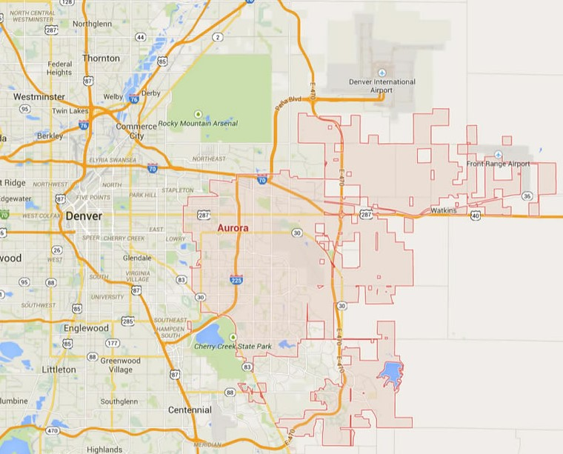
Aurora Colorado - City Highlights
2023 Budget $1.148 Billion ($815.9 Million is for operating and $332.5 Million is for capital) and General Fund Budget $475.4 Million
Services include Police, Fire, Public Works, Parks, Recreation, Libraries, Water, Sewer, etc.
Located in three counties and is the third largest City in the State.
  It is the largest city in Colorado that utilizes a Council/Manager form of government.
Located between the State’s two largest employment centers: downtown Denver and the Tech Center.
  Aurora also has great access to transportation alternatives including light rail, commuter rail, and the E-470 toll way loop.
  Proximity to DIA and the growing Aerotropolis provides additional transportation/development options as well as employment opportunities for residents.
Incorporates more than 160 square miles and almost 40% remains undeveloped*.
Population continues to grow as areas of the City are developed.
  Aurora’s population (378,826) has increased over 40% since 2000.
* The City is projecting full build out by 2070.

Slide 3
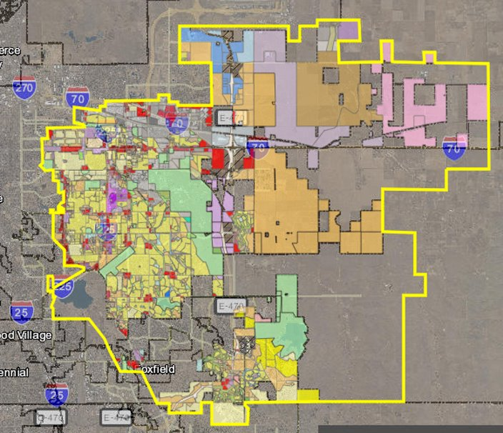
Aurora Colorado – Some Challenges
Water:
Leader in water conservation and water re-use. Council just approved a new water conservation/non-functional turf ordinance to continue this leadership.
The new ordinance establishes a strong ethic of water efficient landscapes for future growth within Aurora.
Capital Plan:
Over the last two years, conducted extensive capital planning process resulting in a draft Capital Infrastructure Master Plan (Capital Plan).
The Capital Plan includes over $700 million in prioritized transportation, parks and facilities capital needs.
Implementation of the Capital Plan will include the education and engagement of residents regarding the City’s capital needs, funding strategies, etc.
Staffing:
Turnover of city staff exceeding 18% in 2022, now beginning to improve.

Slide 4


What
How
Thriving Communities
Resource |Educator |Advocate |Facilitator
Why
Advance excellence in gov’t finance

Slide 5





Slide 6
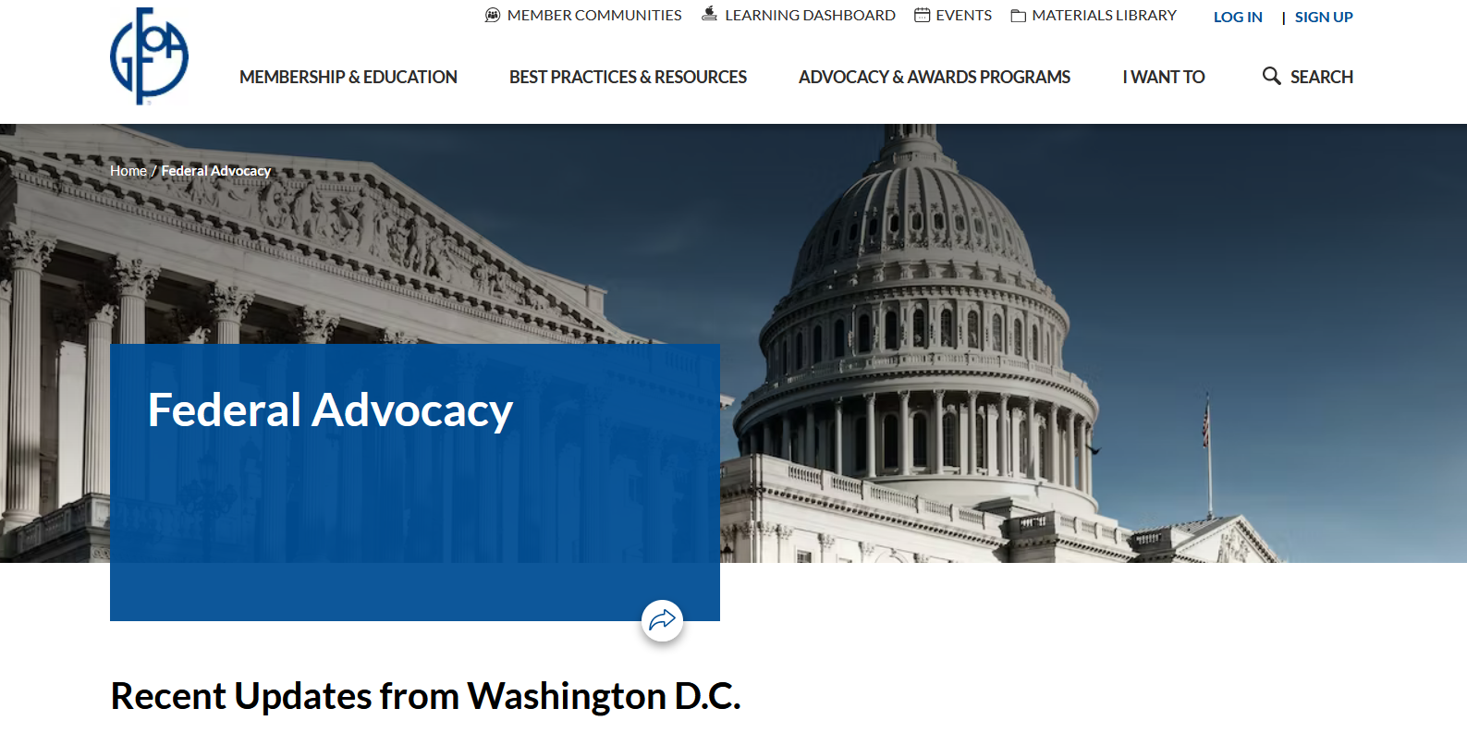

Slide 7
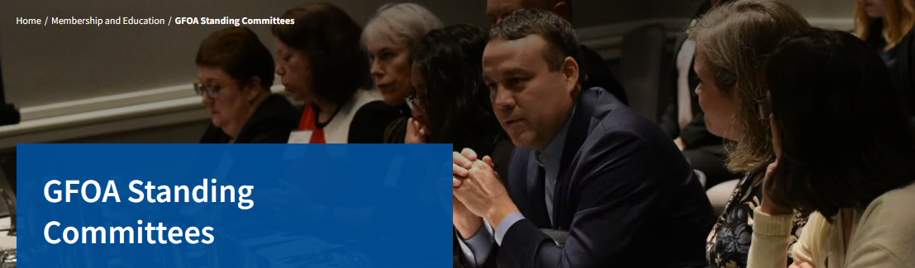
Accounting, Auditing, and Financial Reporting Committee
Committee on Governmental Budgeting & Fiscal Policy
Committee on Governmental Debt Management
Committee on Economic Development & Capital Planning
Committee on Retirement and Benefits Administration
Committee on Treasury & Investment Management
Committee on Canadian Issues

Slide 8







Slide 9
Networking Groups
Black Caucus
Women’s Public Finance Network
Urban Forum
Small Government Forum
Utility Finance Forum
Alliance for Excellence in School Budgeting
LGBTQIA+
Hispanic Network

Slide 10

Learning Management System (LMS)

Slide 11

Certified Public Finance Officer
Two full scholarships per state/province

Slide 12
Certified Public Finance Officer

Slide 13



Future of the profession initiative
$120,000

Slide 14
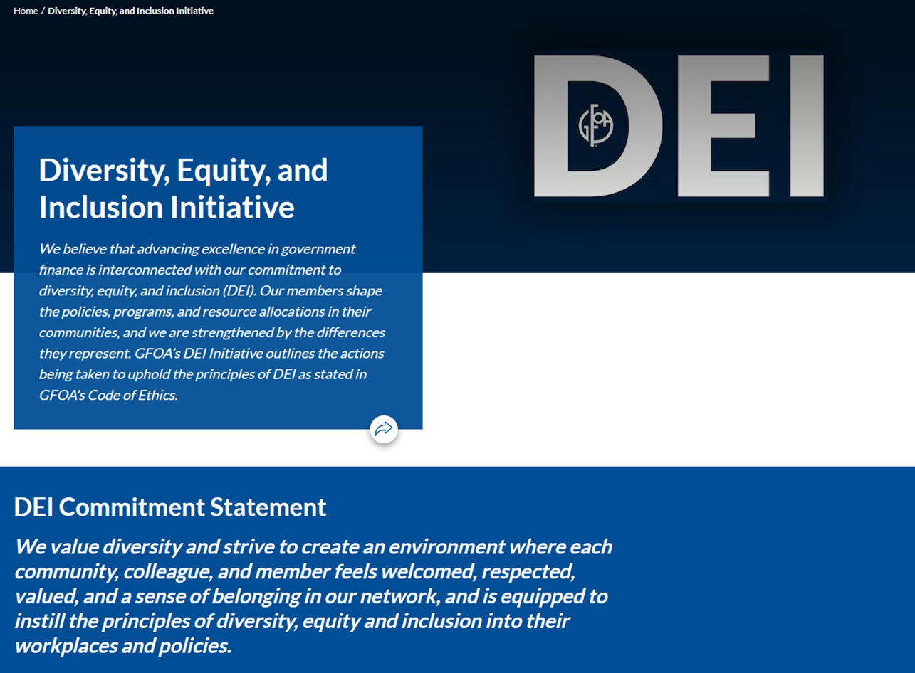

Slide 15
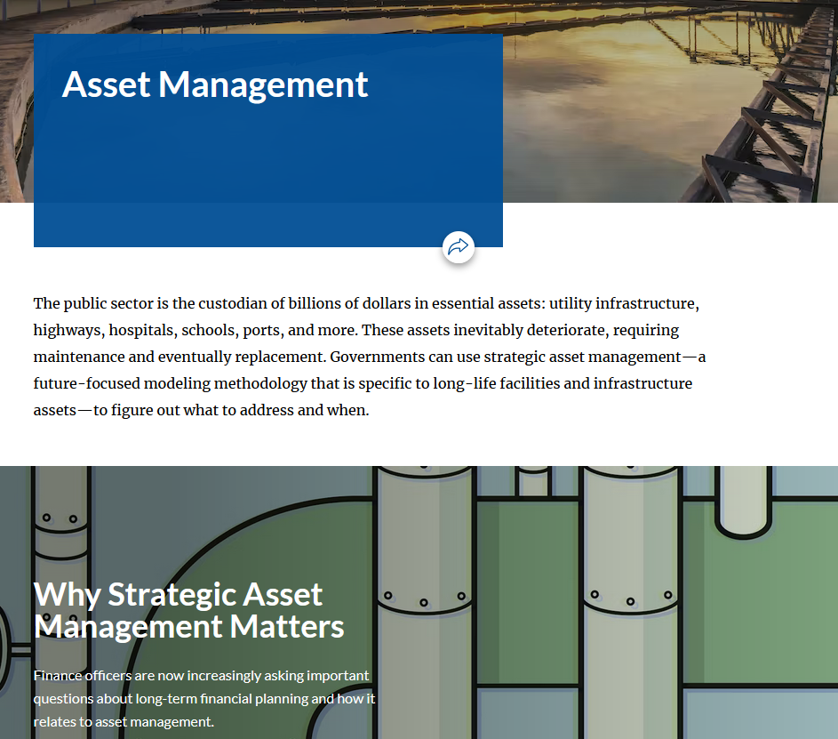

Slide 16
Capital Planning should begin with Asset Management
“Do less better”
-Kyle Wedberg, Ph.D., GFOA
How well does the jurisdiction function today?
  Focus on the performance of what exists
“Campaign in poetry, govern in prose”
-Mario Cuomo, Former Governor of New York
Elected Officials and Legislative Bodies/Members and New Projects
  Cutting ribbons is an expensive addiction
  New projects can displace available resources from existing

Slide 17
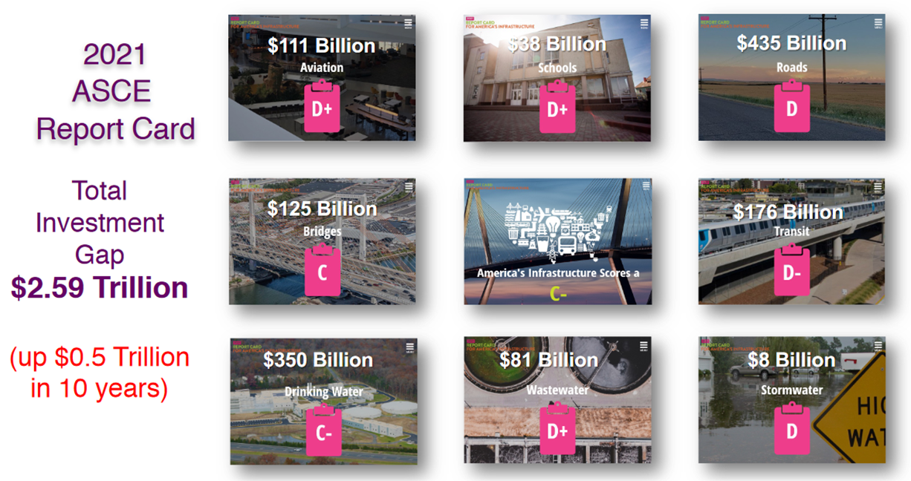
ASCE’s Report Card for America’s Infrastructure
*Source - American Society of Civil Engineers 2020 Report Card for America’s Infrastructure

Slide 18
Asset Management: Leadership
“Take better care of what we gave you”
-Your mother
Government can not build itself to growth and resiliency solutions
  Cost
  Environmental conditions
  Asset lifecycle
Administrative Leadership Finance and Public Works alignment

Slide 19
Asset Management: Tools to Manage
Doing the work is important, but telling the story is just as important. The story is where history, the present realities, and the future all come to life.
Long Term Financial Plan – LTFP
  What are our resources?
Asset Management
  What do we own?
  Where is it?
  What condition is it in?
Capital Improvement Plan – CIP
  What projects are we focusing on for the next five to ten years?
  What can we afford?
  What will we address or not address?

Slide 20
GFOA Initiatives in Asset Management
First time GFOA Class on Asset Management
  Class offered twice in 2023
Partnership with International Leaders
  Shared presentations at annual conferences
  Participation of GFOA in IPWEA Classes and Text Redrafts
Community Economic Development and Capital Planning Committee – CEDCP
GFOA Conference Pre-conference and Sessions
Presentations at State GFOA

Slide 21

New Scholarship Opportunity
The GFOA Leadership Development Scholarship
(GLDS) program is available to assist working
professionals with funding to advance their careers
in public finance. Current members of GFOA
are eligible to apply for a scholarship
to cover training and/or travel costs for GFOA’s
Leadership Academy and in-person training
events (the annual GFOA conference is excluded.)
This means you ☺

Slide 22

Hope to see you next year in…
50 First Time attendee scholarships for each state/province

Slide 23
Thank You
Notes:
Thank you.

