Slide 1

Introduction to the Bond Issuance Process
Alaska Government Finance Officers Association
Annual Conference
December 8, 2023
Speaker:
Michael Newman
Senior Managing Director
Hilltop Securities Inc.
6100 Fairview, Suite 550
Charlotte, NC 28210
Phone: 469.830.2185
michael.newman@hilltopsecurities.com

Slide 2

Table of Contents
Tab 1: Introduction
Tab 2: Participants in Bond Issuance Process
Tab 3: Bond Issuance Process
Tab 4: Disclosure Statement

Slide 3

INTRODUCTION
Tab 1

Slide 4
What is a Municipal Bond?
Issued to finance public purpose projects
An obligation to pay interest and repay principal on or prior to maturity
Interest is typically paid semi-annually; principal is typically paid annually
Interest income to a holder of a municipal bond may be excludable from gross income for federal income tax purposes (Tax-Exempt Income) or includable in gross income for federal income tax purposes (Taxable Income) depending on the use of proceeds.
Interest income to a holder of a municipal bond may or may not be subject to state income tax
Most common types of municipal bonds:
  General Obligation Bonds
  Revenue Bonds
Why issue municipal bonds:
  Low cost due to tax-exemption
  Pay for assets over their useful life

Slide 5
Difference between Revenue and Tax-Supported Debt
Revenue Bonds are not backed by the full faith and credit of the Issuer, consequently they do not require electoral approval
Revenue Bonds are only supported by a revenue stream from an enterprise fund or a revenue producing project; or by federal revenues.
Bondholders are dependent upon revenues from the specific enterprise or project to be repaid the principal of and interest on the related bonds
Revenue Bonds typically sell at interest rates higher than comparably rated General Obligation Bonds
  Some investors prefer essential service Revenue Bonds to General Obligation Bonds due to improved standing in the event of bankruptcy

Slide 6
Forrer Decision by Alaska Supreme Court
Lease Revenue Bonds and Certificates of Participation are not debt from a State of of Alaska Constitution perspective where the lease:
  Contains a non-appropriation clause;
  Limits recourse to the leased property; and
  Does not create a long-term obligation binding future generations or governing bodies.
A non-appropriation clause alone has been found by the Alaska Supreme Court to not be sufficient for a lease revenue bond or certificate of participation to be constitutional absent a vote of the people.
The leased property was found by the Alaska Supreme Court to limit the recourse of the holder of the lease revenue bond or certificate of participation.
  Recourse must be constrained to an identifiable asset that is not government owned
This description is only a brief summary of issues relating to Lease Revenue Bonds and Certificates of Participation and is not intended as legal advice. You should consult your Bond Counsel for further information regarding Lease Revenue Bonds and Certificates of Participation.

Slide 7
PARTICIPANTS IN BOND ISSUANCE PROCESS
Tab 2

Slide 8
Participants in Process
Issuer
Bond Counsel
Investors
Trustee
Underwriter
Paying Agent
Rating Agencies
Municipal Advisor
Notes:
Kayla

Slide 9
Professionals Involved in the Debt Issuance Process
Municipal Advisor
  A consultant who advises the Issuer on matters pertinent to the bond issue, such as plan of finance, structure, timing, marketing, fairness of pricing, terms, and bond ratings
Bond Counsel
  A specialized attorney retained by the Issuer to give legal opinions that the Issuer is authorized to issue the bonds, and interest on the proposed securities will be exempt from federal income taxation (if applicable)
Underwriter(s)
  A securities dealer which purchases municipal securities for resale; the Underwriter may acquire the securities by either competitive or negotiated sale and may purchase the securities in a group with other Underwriters (an Underwriting Syndicate)

Slide 10
Professionals Involved in the Debt Issuance Process – Cont’d
Underwriter’s Counsel
  A specialized attorney retained by the Underwriter to conduct due diligence on the Issuer and draft continuing disclosure requirements for the issue, as well as an Official Statement if a Disclosure Counsel is not engaged by the Issuer
Paying Agent/Registrar
  A specialized attorney retained by the Underwriter to conduct due diligence on the Issuer and draft continuing disclosure requirements for the issue, as well as an Official Statement if a Disclosure Counsel is not engaged by the Issuer
  A financial institution that tracks ownership of the securities and makes payment, from funds of the Issuer, of debt service to holders of the bonds
Trustee
  A financial institution with trust powers that acts in a fiduciary capacity to facilitate the collection, escrow, and distribution of funds for the benefit of the holders of the bonds
Credit Rating Agencies
  Independent for-profit corporations that evaluate the credit quality of debt instruments and assign credit ratings for a fee
  Moody’s Investors Service, Standard & Poor’s and Fitch Ratings are the three main credit rating agencies, with Kroll Bond Ratings seeking to establish itself as a main credit rating agency

Slide 11
Municipal Advisory Rule
Effective July 1, 2014
Defines a “Municipal Advisor” (“MA”) as a person who is not a municipal entity or employee of a municipal entity that:
  Provides advice to or on behalf of an Issuer with respect to municipal financial products or the issuance of municipal securities, or
  Undertakes a solicitation of an Issuer
MA’s have an explicit fiduciary duty to clients
Underwriters and other professionals that do not have a fiduciary duty to Issuers will not be able to provide advice to an Issuer absent being deemed a MA unless certain exemptions are met:
  RFP Exemption: the underwriter is responding to a RFP
  Underwriting Exemption: the underwriter has been hired for a specific transaction
  Independent Registered Municipal Advisor (IRMA) Exemption: the Issuer has engaged an independent municipal advisor
    The MA must be registered and independent, meaning the MA shall not have anyone working on the financial advisory team for a client who has been associated with the soliciting underwriter in the past two years
    The Issuer must represent in writing that it is being represented by a MA
    The underwriter must confirm receipt of the Issuer’s representations for the IRMA Exemption and must disclose to the Issuer and the IRMA that the underwriter is not a MA and does not have a fiduciary duty to the Issuer
All state and local government employees, board members, committee members and others are clearly exempted from the Rule when acting in their official capacity

Slide 12
Municipal Advisor
Advises the Issuer on all matters regarding the bond issuance, including structure, timing, marketing, fairness of pricing, terms and bond ratings
A qualified Municipal Advisor should possess specialized transaction, legal, structuring and market knowledge to use in developing the most advantageous plan of finance and debt structure
  A thorough knowledge of capital markets is crucial to cost-effective structuring of debt issues
Issuer’s representative in and to the bond market
  Serves as the Issuer’s investment banking expert
  Provides ongoing link between such parties as underwriters, insurers, investors, regulators, trade groups, and an Issuer
Acts as a primary contact together with the Issuer for rating agencies and providers of credit enhancement and liquidity support
Evaluates the cost effectiveness of various financing alternatives
Provides the Issuer with access to real-time market information, and notification of changes in market conditions
Assures that Issuer is well informed in all phases of the transaction, including pricing and distribution
Provides ongoing services apart from bond sales

Slide 13
Municipal Advisor
Recommends the method of sale that maximizes the marketability of the Issuer’s debt and minimizes the overall borrowing cost
  Obtains the broadest possible participation in bidding on competitive sales
  In negotiated sales – represents the Issuer in all areas of pricing and sale to ensure that the Issuers’ bonds are sold at the most favorable rates possible
Coordinates the entire bond issuance process and all parties involved
  Assists with the preparation of offering documents and review of bond documents
  Works closely with the Issuer, underwriters, bond counsel, underwriter’s counsel, and other participants
Acts as a primary contact together with the Issuer for rating agencies and providers of credit enhancement and liquidity support
  With regards to bond ratings
  Determines the relative strengths and weaknesses from a credit standpoint
  Assists with establishing bond rating goals
  Provides guidance to maintaining or improving bond ratings
  Comments on credit implications of local actions and events
  Assistance in negotiations with providers of credit enhancement and liquidity support
  Assists in determination that cost of third-party support is reasonable and provides net financial benefit to the Issuer

Slide 14
Bond Counsel
An attorney, retained by the Issuer, who gives a legal opinion that the Issuer is authorized to issue the proposed securities, the Issuer has met all legal requirements necessary for issuance, and interest on the proposed securities will be exempt from federal income taxation
Addresses legal issues associated with the financial structure of the transaction and works with the bond team to resolve all issues
Responsible for preparing bond and closing documents, with input from other counsel and members of the financing group
Provides legal opinions at closing that
  Bonds and underlying documents are valid and binding obligations of the Issuer
  Preliminary official statement and official statement accurately describe the bond documents
  Prepares transcript of bond proceedings containing legal documents related to the sale of the bonds and distributes transcript to Issuer and members of the financing group

Slide 15
Additional Counsel
Issuer’s Counsel
  Reviews and comments on documents from the perspective of the Issuer’s interests
  Provides legal opinion at closing that (a) major bond documents adopted by the Issuer are valid and binding on the Issuer and (b) the Preliminary Official Statement and Official Statement accurately describe the Issuer
Underwriter’s Counsel
  Hired and paid by the Senior Managing Underwriter to represent the underwriters in the transaction
  Prepares Bond Purchase Agreement and the Agreement Among Underwriters
  Absent Disclosure Counsel, typically prepares the Preliminary Official Statement, Official Statement and Continuing Disclosure Agreement
Disclosure Counsel
  Responsible for preparation of Preliminary Official Statement, Official Statement and Issuer’s Continuing Disclosure Undertaking
  Provides opinion at closing that Official Statement does not contain any misstatements of material facts or omit material facts

Slide 16
Underwriting Syndicate and Selling Group Members
The sale of bonds may involve a Senior Manager, Co-Managers, and Selling Group
  The Senior Manager takes the lead in structuring the financing on behalf of the underwriting syndicate and coordinating pricing thoughts of the Syndicate
No one investment banking firm (e.g. Underwriter) has perfect market penetration
  An Issuer should have a balanced Underwriting Syndicate
  Strong in institutional and retail distribution
  May include Wall Street Firms, Regional Firms, Local Firms and Minority Firms
Senior Manager and Co-Managers should be willing to risk their capital by underwriting unsold balances
Senior Manager and Co-Managers should create a secondary market in the debt of the Issuer being underwritten, their provision of an active secondary market in the debt will improve market liquidity allowing the Issuer to realize more favorable interest rates.
Selling group members have no liability for unsold balances and receive compensation only to the extent they sell bonds.

Slide 17
Underwriting Syndicate and Selling Group Members
Senior Manager
  Negotiates the underwriter’s discount, interest rates and yields on behalf of the Underwriting Syndicate
  Coordinates financing plan with the Issuer and Municipal Advisor, which includes structuring, pricing and marketing strategy
  Maintains communication with the Issuer, Municipal Advisor and other syndicate members
  Aggressively supports the financing to assure the Issuer the lowest possible borrowing cost
Co-Managers
  Increase market penetration and distribution
  Add to the marketing capability of the team by either having local presence, middle market capabilities or the ability to bring niche investors to the table
  Willing to commit capital
  Put orders in for those bonds that are not fully subscribed and therefore support the deal with their capital
  Care must be taken not to expand number of co-managers to point that participation for each will be diluted beyond reasonable level of interest
Selling Group
  If used, will provide retail order support to expand distribution and help lower borrowing cost
  Not members of underwriting syndicate

Slide 18
Investors
Retail
  Individual Investors
  Includes trust and/or advisory accounts (e.g., Separately Managed Accounts or “Professional Retail”)
Middle Market
  Banks
  Small mutual insurance companies
  Local and regional money managers and investment advisors
Institutional
  Property and Casualty Insurance Companies
  Bond Funds
  Other large buyers such as large corporations
  Hedge Funds/Trading Accounts

Slide 19
Breakdown of Typical Investor Demand by Bond Maturity
Shortest Bond Maturities
  Individual Retail Investors
  Trust Accounts
  Corporations
  Bond Funds
  Money Market Managers
Intermediate Bond Maturities
  Banks
  Bond Funds
  Insurance Companies
Longest Bond Maturities
  Bond Funds
  Insurance Companies
  Individual Retail Investors
  Arbitrage

Slide 20
BOND ISSUANCE PROCESS
Tab 3

Slide 21
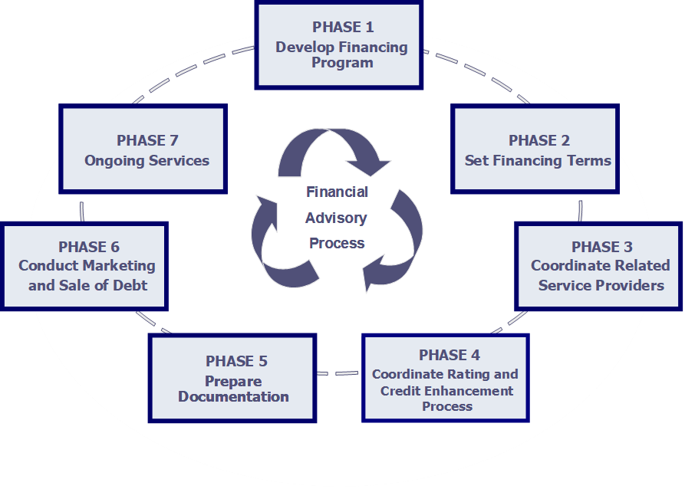
Bond Issuance Process - Overview
Develop Financial Plan
Develop Debt Structure
Drafting of Documents
Obtain Authorization to Issue Debt
Receipt of Credit Rating(s)
Marketing of Bonds
Pricing of Bonds
Closing and Delivery of Bonds

Slide 22
Bond Issuance Process - Details
Phase 1: Develop Long-Range Financing Program | Phase 2: Determine Financing Terms | Phase 3: Coordinate Related Service
Conduct Survey of Financial Needs & Resources Review Existing Debt Structure Analyze Full-Range of Financing Alternatives Develop Financial Objectives & Plan of Finance Bond Election Planning and Assistance, if Applicable | Appropriate Size and Structure of the Financing Design Issue Features & Terms Evaluate Market Innovations Analyze Credit Needs Determine Method of Sale and Financing Schedule | Coordinate with Bond Counsel to Meet Legal Requirements Evaluate Underwriters for Negotiated Sales Arrange Related Service Providers
Phase 4: Prepare Documentation | Phase 5: Coordinate Rating & Credit Enhancement Process | Phase 6: Conduct Marketing and Sale of Debt
Prepare Offering Documents Assure Compliance with Disclosure Requirements Assure Compliance with Continuing Disclosure Requirements - Rule 15c2-12 | Develop Bond Rating Strategy & Presentation Achieve Highest Possible Credit Rating Evaluate benefits of, and if appropriate solicit Letter of Credit or Bond Insurance | Determine Timing of Sale Coordination of Pre-sale and Pricing Assure Optimum Marketing Plan and Effort Manage Transaction Process and Conduct Sale of Debt Close Transaction Conduct Post-Sale Analysis of Pricing and Underwriter Performance
21
Notes:
Steve

Slide 23
Bond Structuring
Bond Structure – Serial Bonds, Terms Bonds, and Capital Appreciation Bonds
Coupon Structure – The interest rate on the bonds
  A higher coupon (i.e., 5%) is considered a defensive by investors as it increases the likelihood a bond will trade at or above par in a rising interest rate environment and provides issuers with increased optionality.
  A lower coupon (i.e., 3% or 4%) results in a lower yield to maturity for the issuer but provides reduced optionality.
Yield – The return to the investor based on the coupon and price of the bond
Debt Service Reserve Fund – May not be necessary based on credit ratings and market conditions
Cost of Issuance
Call Provisions – Optional and mandatory redemption provisions
  10-year optional redemption provision is standard.
  An optional redemption provision of less than 10 years can be utilized, but if a “short call” is not exercised, it will result in a higher yield to maturity than the standard 10-year optional redemption provision.

Slide 24
Credit Enhancement and Liquidity Facilities
An Issuer may realize a lower cost of funds or realize other financial objectives through the use of credit enhancement and/or liquidity support
  Banks, through the provision of letters of credit, and insurance companies, through the provision of non-cancellable insurance policies provide credit enhancement
  Under a letter of credit, a bank pays investors principal of and interest on the related debt and is reimbursed by the Issuer of the related debt
  Under an insurance policy, an insurance company guarantees the timely payment of principal of and interest on the related debt. The Issuer of the related debt makes all payments of principal and interest, with the insurance company only making a payment upon a payment failure by the Issuer of the debt.
  As a result of the use of credit enhancement, a debt instrument is assigned a credit rating based on such instrument of credit enhancement, typically resulting in a higher rating being assigned to the related debt, resulting in its bearing a reduced interest rate
  Liquidity facilities (e.g., Standby Bond Purchase Agreements and Revolving Lines of Credit) are typically provided by banks. Their purpose is to provide liquidity for investors in the event of a market disruption. A letter of credit provides credit enhancement and liquidity support.

Slide 25
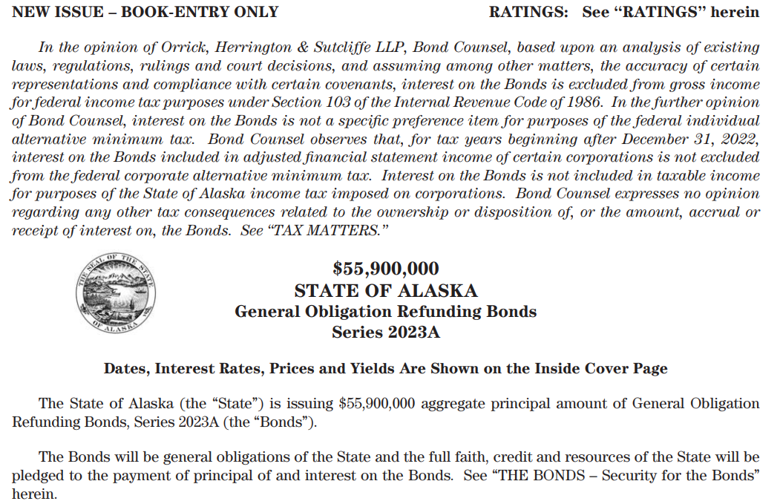
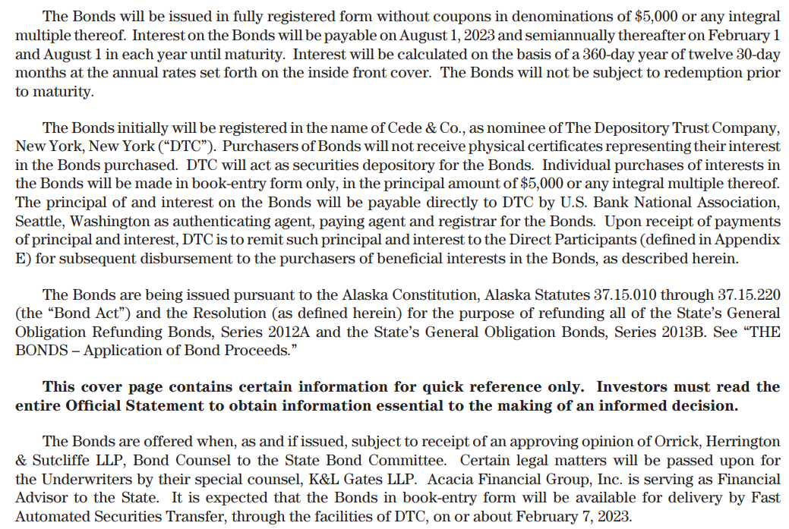
Typical Bond Transaction Documents
Preliminary Official Statement
Final Official Statement
  Full and accurate disclosure
  Responsibility and obligation of the Issuer and its governing body
Continuing Disclosure Agreement
  SEC Rule 15c2-12
Indenture of Trust or Bond Resolution
Bond Purchase Agreement

Slide 26
Rating Agencies
What is a bond rating?
  Method designed for the purpose of ranking bonds according to their relative credit risk
  Objective evaluation of risk provided to investors who might buy or own the given security
  Consensus opinion of the relative credit risk of the Issuer reached by a group of analysts (i.e., the credit committee)
A rating is NOT…
  A statement of fact about past occurrences OR a guarantee of future performance
  A recommendation to buy, sell or hold a security.

Slide 27
Rating Agencies – Rating Levels
Long Term
Short Term
Moody’s
Fitch / S&P
Moody’s
S & P
Fitch
AAA
Aa1
Aa2
Aa3
A1
A2
A3
Baa1
Baa2
Baa3
Ba1
Ba2
AAA
AA+
AA
AA-
A+
A
A-
BBB+
BBB
BBB-
BB+
BB
MIG 1
MIG 2
MIG 3
SG
SP-1+
SP-1
SP-2
SP-3
F1 (+ or -)
F2 (+ or -)
F3 (+ or -)
B (+ or -)
Lower quality credit
Higher quality credit
Ratings below the line are speculative grade.

Slide 28
Factors Influencing Sale Process
Factors affecting Investor Demand and Pricing of Bonds
  Market Conditions (e.g., Yield)
  Cash Available for Investment
  Forward Supply
  Time of Year
  Economic Data and Interest Rate Expectations
  Structure and Coupon
  Large Bond Issues Get Attention of All Investors
  Small Bond Issues Typically Attract Attention of Retail, Small Money Managers and Middle Market Investors
  Credit Ratings
  Credit Enhancement
  Issuer Name
  Call features

Slide 29
Types of Bond Sales
Competitive Sales
  Bids to buy bonds are accepted at a specified time.
  The bid that results in the lowest effective cost for the Issuer is chosen
Negotiated Sales
  Interest rates and underwriting spread are determined through negotiation with the underwriter(s), who has been previously selected to market and sell the bonds
Private Placements
  Interest rates are determined through negotiation with one or several investors
  Bank direct placements

Slide 30
Competitive vs. Negotiated Sale
Competitive Bid
Bonds sold at a certain date and time
Once announced, time, date, size and structure cannot be changed easily
Underwriter’s discount and insurance cost are imputed in interest rate
Cost is likely higher during volatile market periods and for complex credit structures
Negotiated Sale
Pre-selected syndicate negotiates rates with the Issuer and Municipal Advisor
Pricing occurs 1-3 days prior to award date
Size and structure can be finalized during pricing; often an iterative process
Underwriting spreads are generally less compared to competitive sales during volatile markets since there is less uncertainty involved in the sales process

Slide 31
Competitive Sale
Advantages
  Numerous bids result in fair comparison
  Appearance of an open and fair process
Disadvantages
  Less flexibility in structuring and timing
  Possible “risk premium” and increased financing cost in unstable markets
  Less control over demand and interest rates
  No control over the distribution of bonds

Slide 32
Negotiated Sale
Advantages
  Pre-marketing efforts prepare the market for unusual structure, size, credit or special disclosure
  Flexibility in timing and structuring
  Control of underwriting syndicate and bond allocations
Disadvantages
  Issuer must spend more resources (time) to manage the process and exercise care in preparing for negotiations
  Is the best price the negotiated price?
  Potential charges of favoritism – with respect to engagement of underwriters

Slide 33
Components of Underwriters’ Spread – Negotiated Sale
Management Fee
  Compensation for structuring the issue
Takedown
  Sales commission
  Varies, based on market conditions, and credit quality and term of debt
  Proper level assures strong marketing effort, resulting in most favorable interest rates available
  Not typically negotiated long in advance of sale date
Underwriting Fee
  Compensates for market risk associated with commitment to underwrite (place capital at risk)
Expenses
  Clearance fees, Day loan charges, Munifacts, DTC, CUSIP and MSRB assessments
  Underwriters’ Counsel

Slide 34
Types of Bond Orders
Priority Of Orders
  Retail
  Issuer may give preference to local or in-state retail orders
  National retail orders
  Institutional
  Group Net (designations allocated on a predetermined fixed basis by Issuer)
  Percentage of takedown according to syndicate liability percentages
  Net Designated
  Buyer of the bonds determines which firms will receive credit for the sale
  Investors decides allocation of takedown based on Issuer policy
        Typical policy – no more than 50% to any syndicate member,
        and minimum number of firms required to be designated
  Member Orders
  Selling firm receives 100% of the credit and commission
  Usually for inventory (referred to as stock) and have lowest priority with respect to fulfillment
  Selling group orders
  Non-retail orders may or may not be permitted, varies by sale

Slide 35
Bond Sale/Pricing Process – Negotiated Sale
Week Prior to Pricing
Preliminary structure shown to sales personnel and potential investor base
  Sales Memo (internal distribution within members of underwriting syndicate)
  Distribute Preliminary Official Statement to potential investors
  An Investor Marketing Presentation may be distributed to potential investors with Preliminary Official Statement
  Advertise issue on national calendar
Determine if retail order period is warranted
Very preliminary price talk with potential investors
Feedback from investors collected as to bond structure, coupons, call features, etc.
Communicate with the market via Bloomberg and Bond Desk Syndicate

Slide 36
Bond Sale/Pricing Process – Negotiated Sale
Day Prior to Pricing
Request price views from senior manager and co-managers
Underwriting syndicate firms up structure and price with Issuer and Municipal Advisor based on market conditions
Pre-pricing call with Issuer, Municipal Advisor and underwriting syndicate
Underwriting syndicate continues to receive feedback from potential investors

Slide 37
Bond Sale/Pricing Process – Negotiated Sale
Day of Pricing
Finalize structure for the price release
Senior Manager receives permission to release pricing information from Issuer and Municipal Advisor and sends out pricing wire with scale, priority of orders and designation policy
Run order period (1-2 hours is common practice) for bonds. During such time orders are received and process monitored by Issuer and Municipal Advisor
Review results of pricing and reprice if appropriate
Senior Manager negotiates the final price with Issuer and Municipal Advisor. At conclusion of discussions, Senior Manager commits to underwrite the transaction on behalf of itself and the underwriting syndicate and receives the verbal award of the bonds.
Senior Manager allots bonds to investors (and members of the underwriting syndicate and selling group) pursuant to the order priority, subject to review and approval of Issuer and Municipal Advisor.

Slide 38
Bond Closing and Post-Closing Activities – Negotiated Sale
Post-Pricing and Bond Closing Activities
Print and distribute Official Statement within seven business days after pricing (Requirement of SEC)
At closing, the bonds are delivered to the account of the Senior Managing Underwriter against receipt of the purchase price by wire to the Bond Trustee
Post-Closing Activities
Continuing Disclosure
Arbitrage Rebate Compliance – Tax-Exempt Debt Only
Monitor Refunding Opportunities to Reduce Interest Expense

Slide 39
DISCLOSURE STATEMENT
Tab 4

Slide 40
Disclosure
The general market commentary herein is intended for educational and informational purposes only and does not constitute legal or investment advice, nor is it an offer or a solicitation of an offer to buy or sell any investment or other specific product. Information provided in this market commentary was obtained from sources that are believed to be reliable; however, it is not guaranteed to be correct, complete, or current, and is not intended to imply or establish standards of care applicable to any attorney or advisor in any particular circumstances. This market commentary represents historical information only and is not an indication of future performance. This market commentary may not be shared with anyone other than the intended recipient without the explicit written consent of HilltopSecurities.
This information is intended to be a summary of general market information. HilltopSecurities is not recommending an action to you as the municipal entity or obligated person. This commentary does not represent municipal advice pursuant to Section 15B of the Exchange Act. HilltopSecurities is acting for its own interests. You should discuss any information and material contained in this communication with any and all internal or external advisors and experts that you deem appropriate. When not already acting as a municipal advisor, HilltopSecurities could seek to serve as an underwriter on a future transaction. The primary role of an underwriter is to purchase securities with a view to distribution in an arms-length, commercial transaction with the issuer. The underwriter has financial and other interests that differ from those of the issuer.

